Slide 1


Slide 2


Slide 3
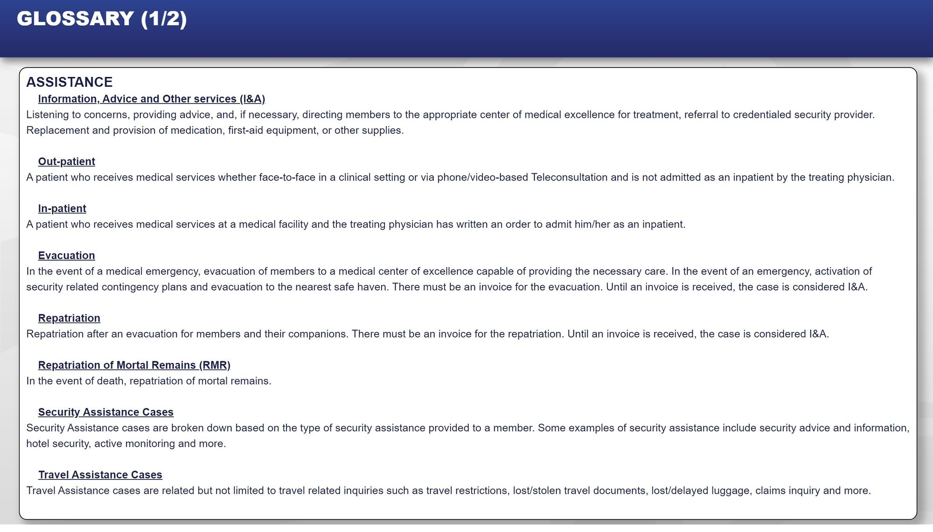

Slide 4
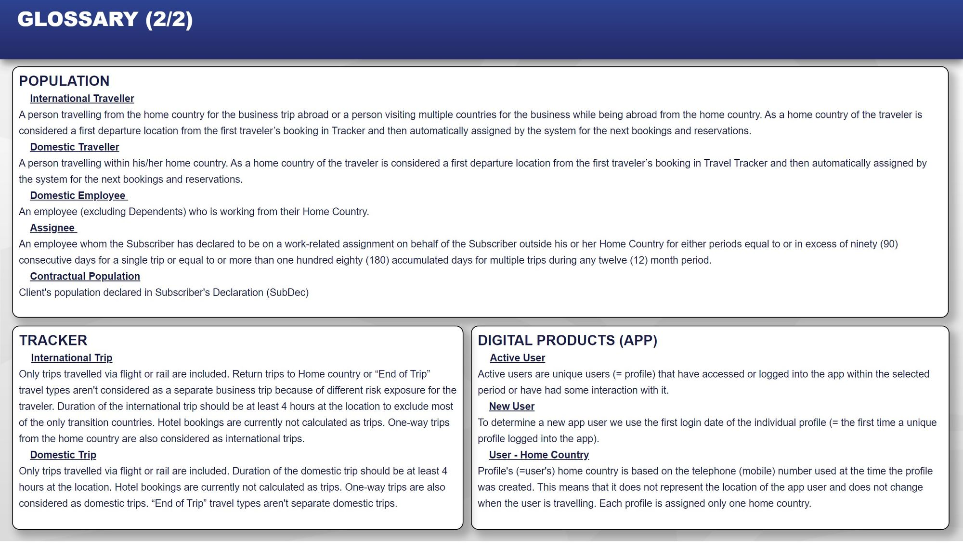

Slide 5
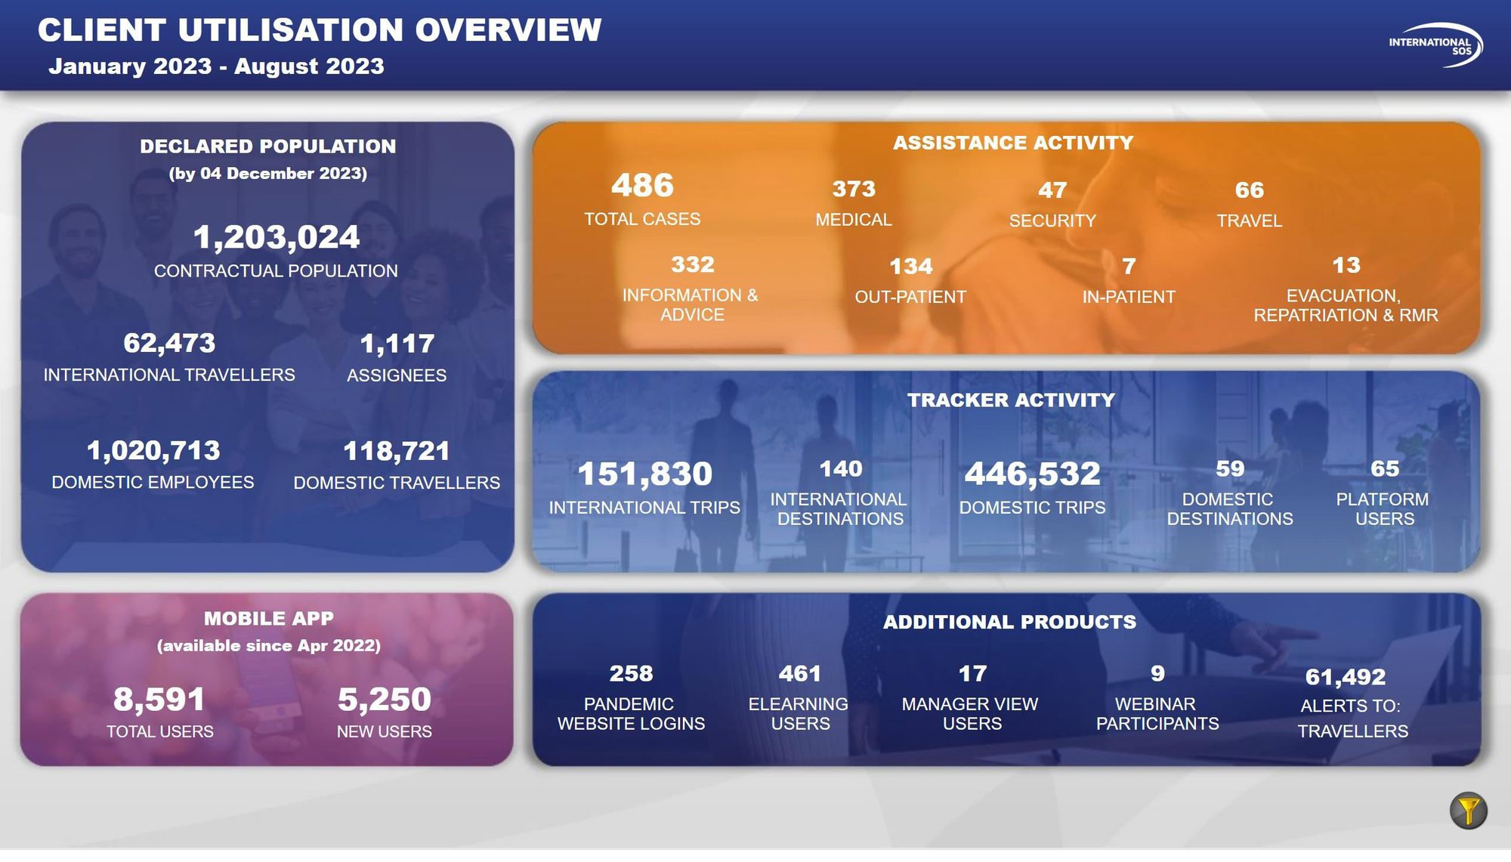

Slide 6
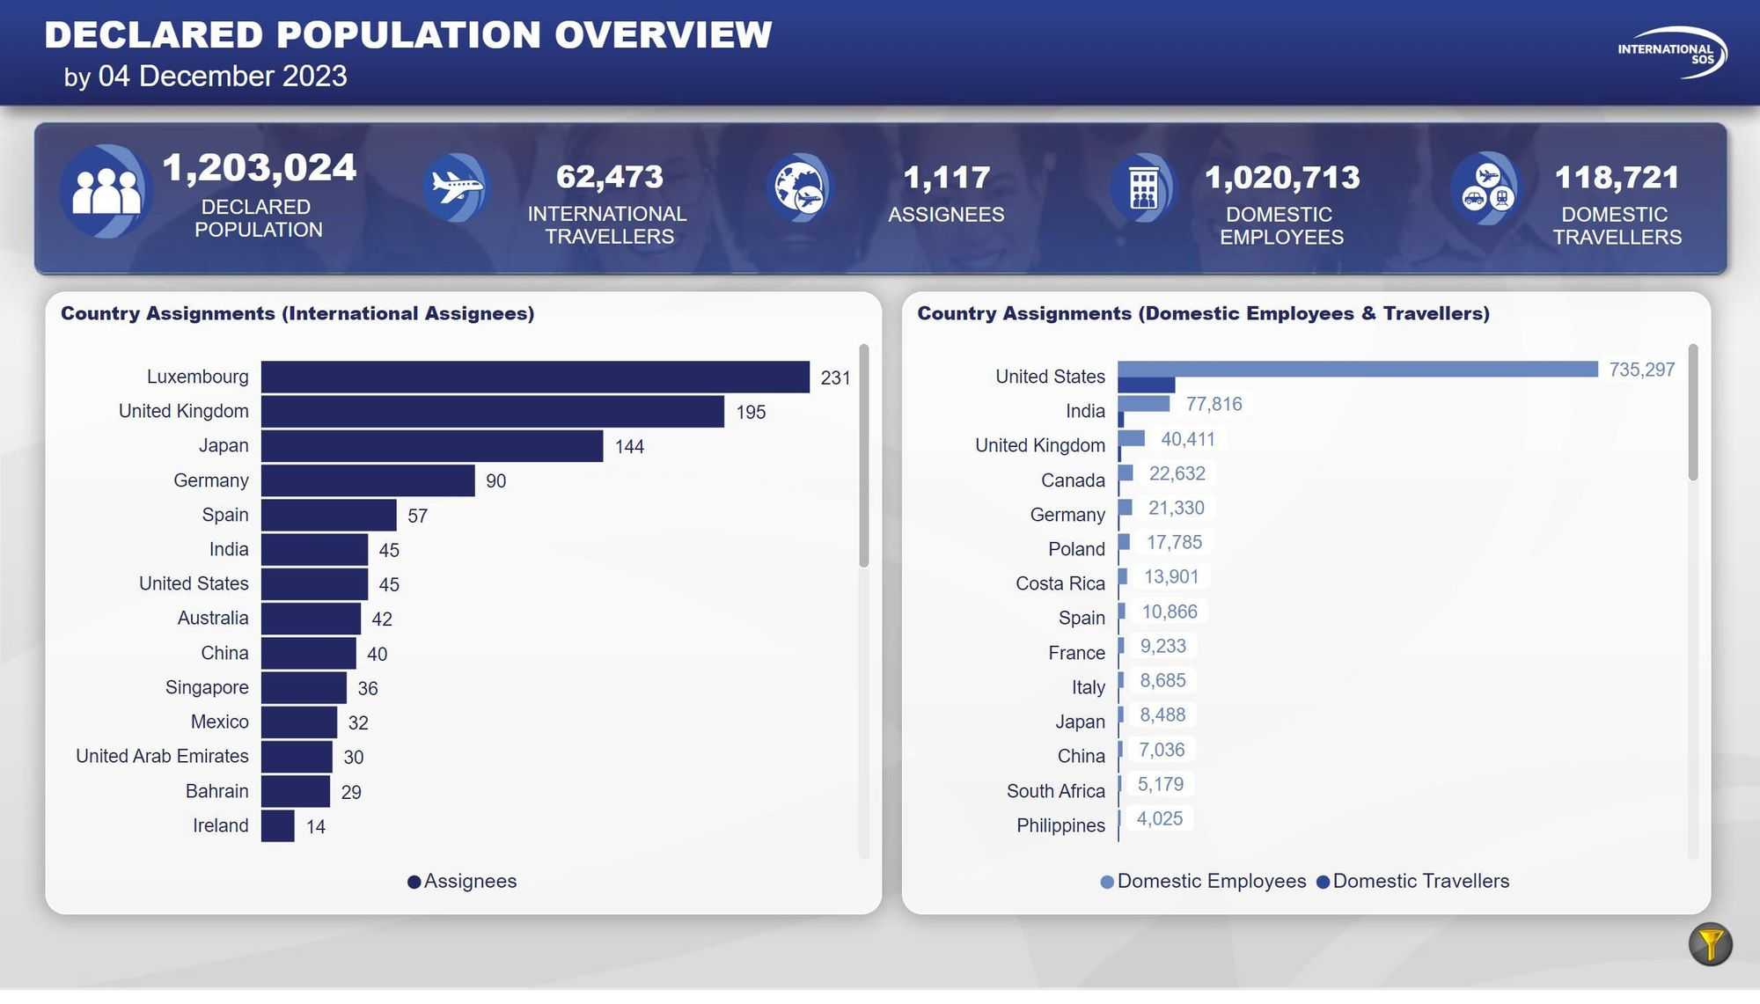

Slide 7
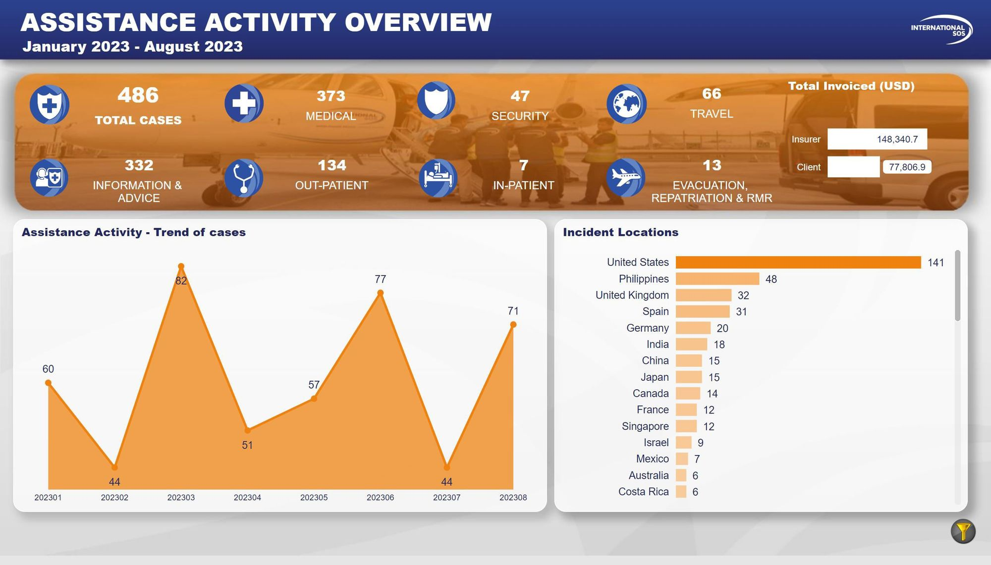

Slide 8
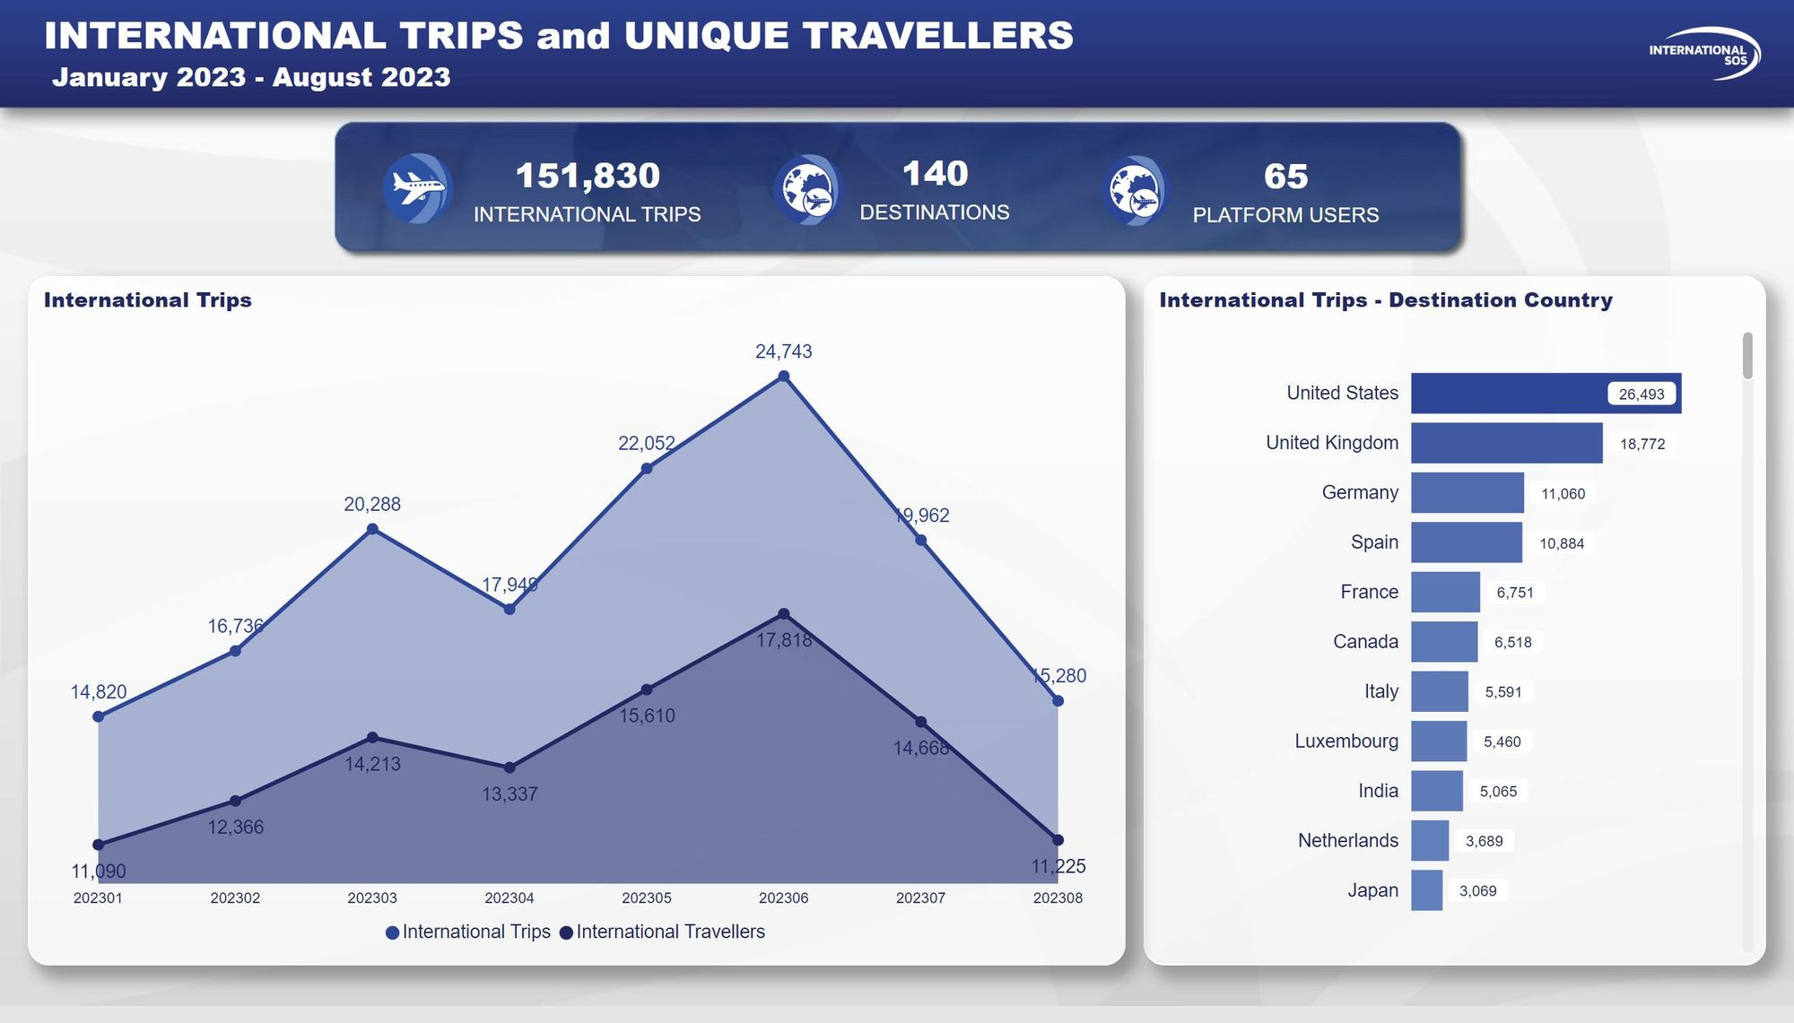

Slide 9
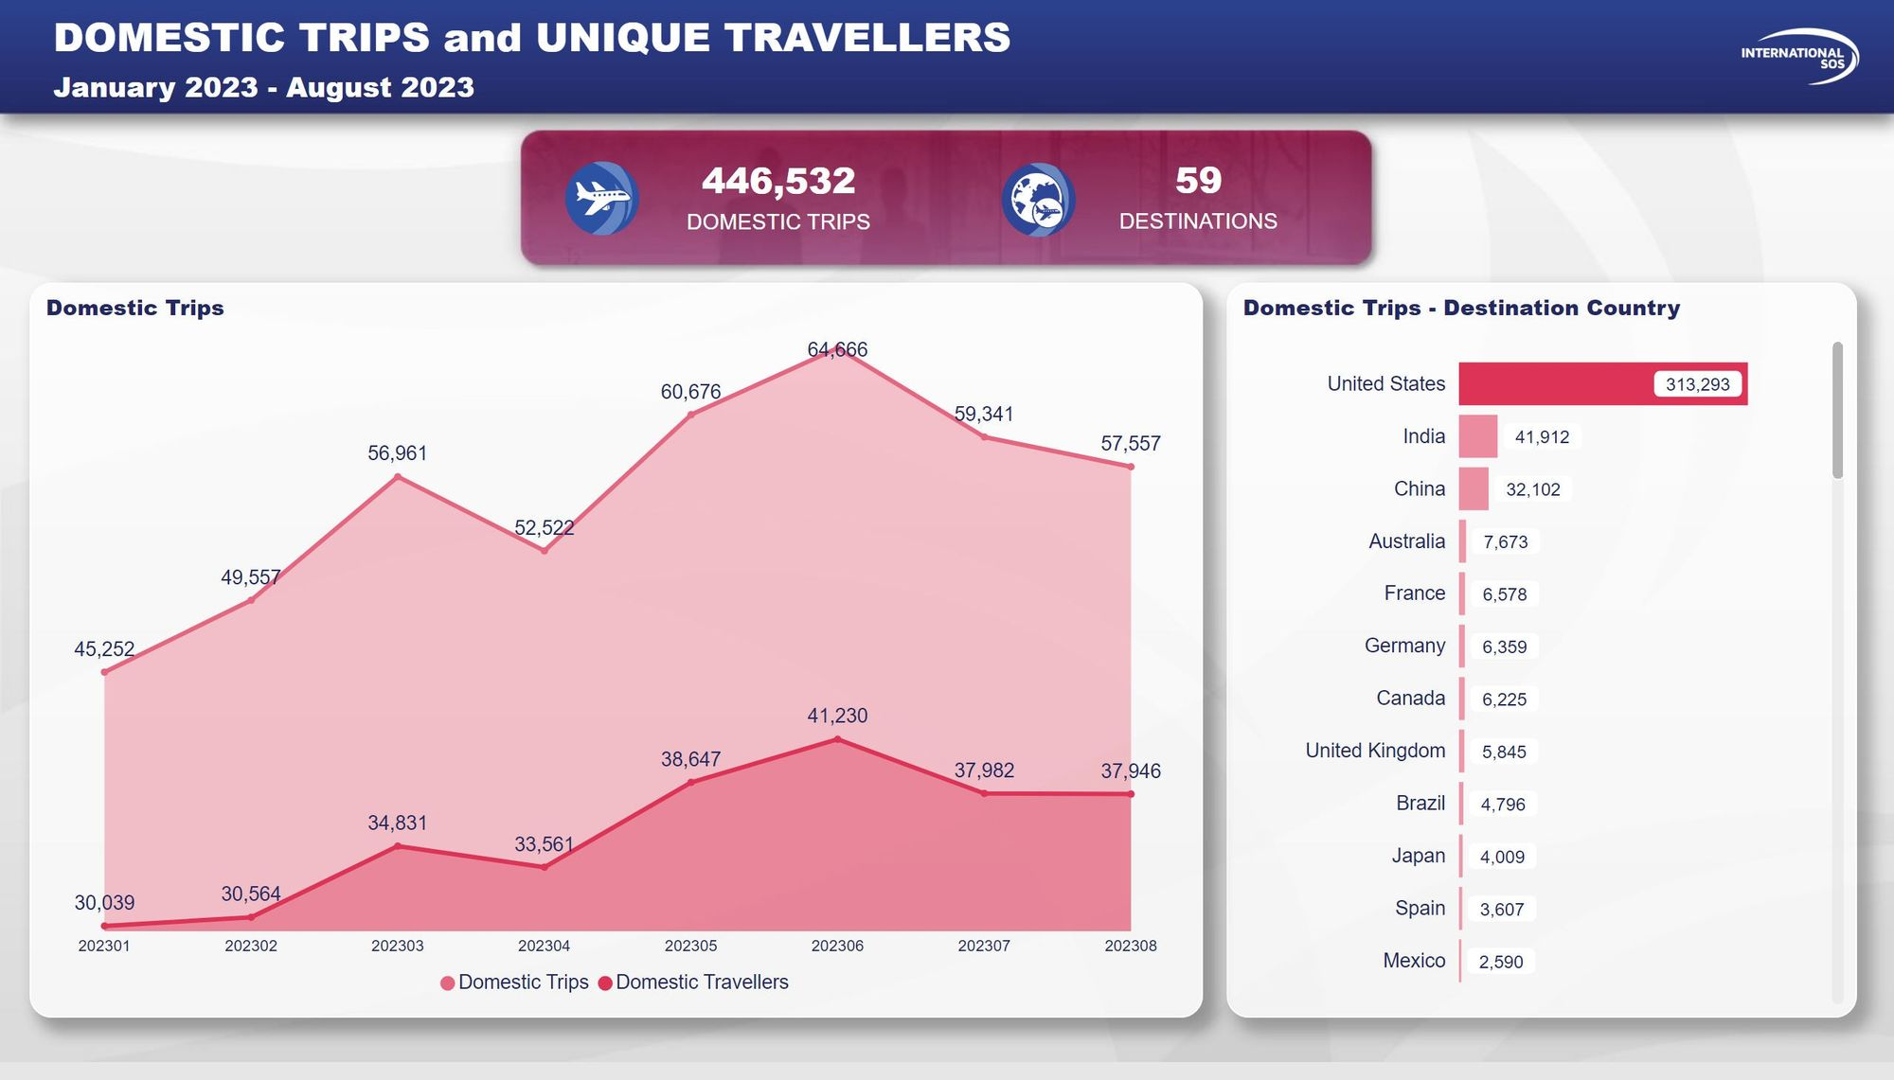

Slide 10
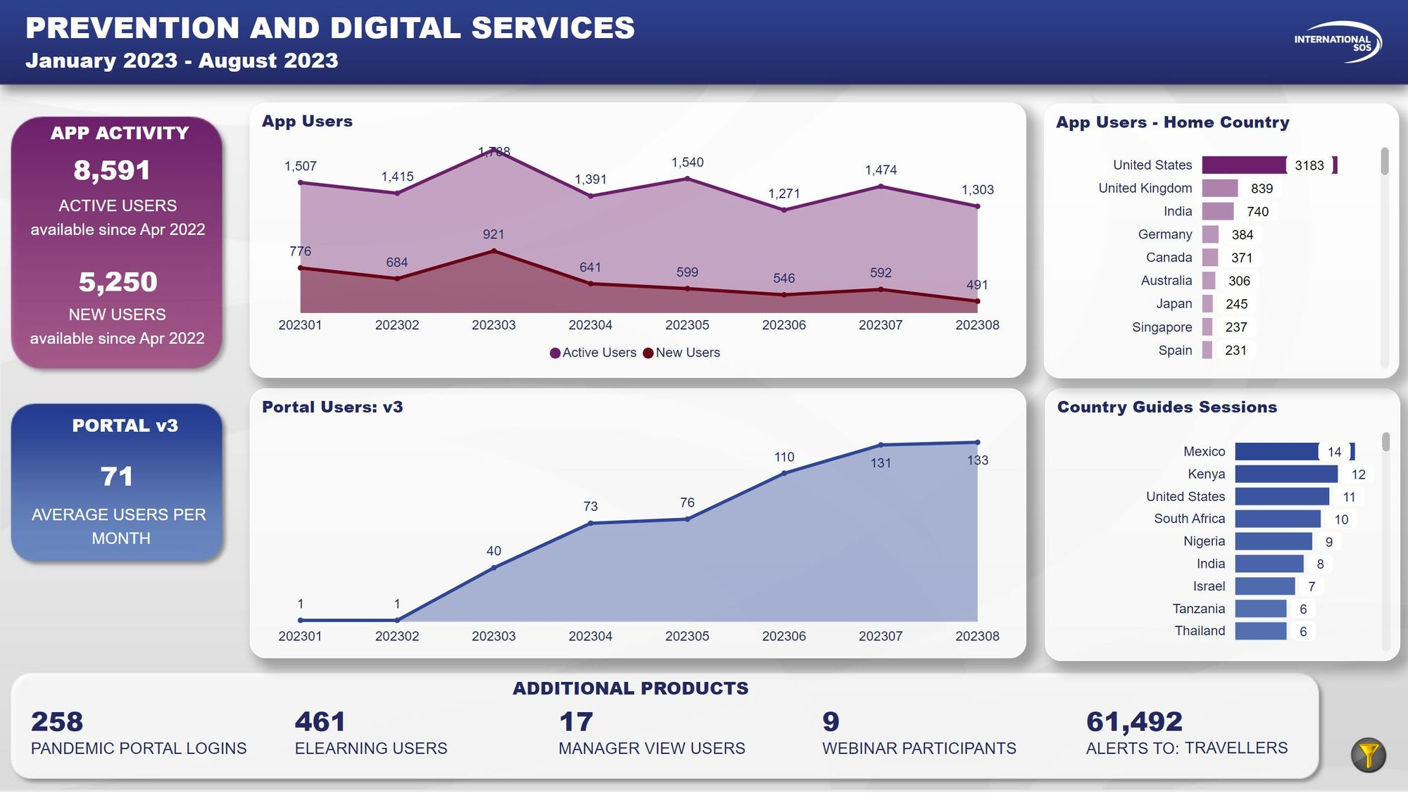

Slide 11


Slide 12
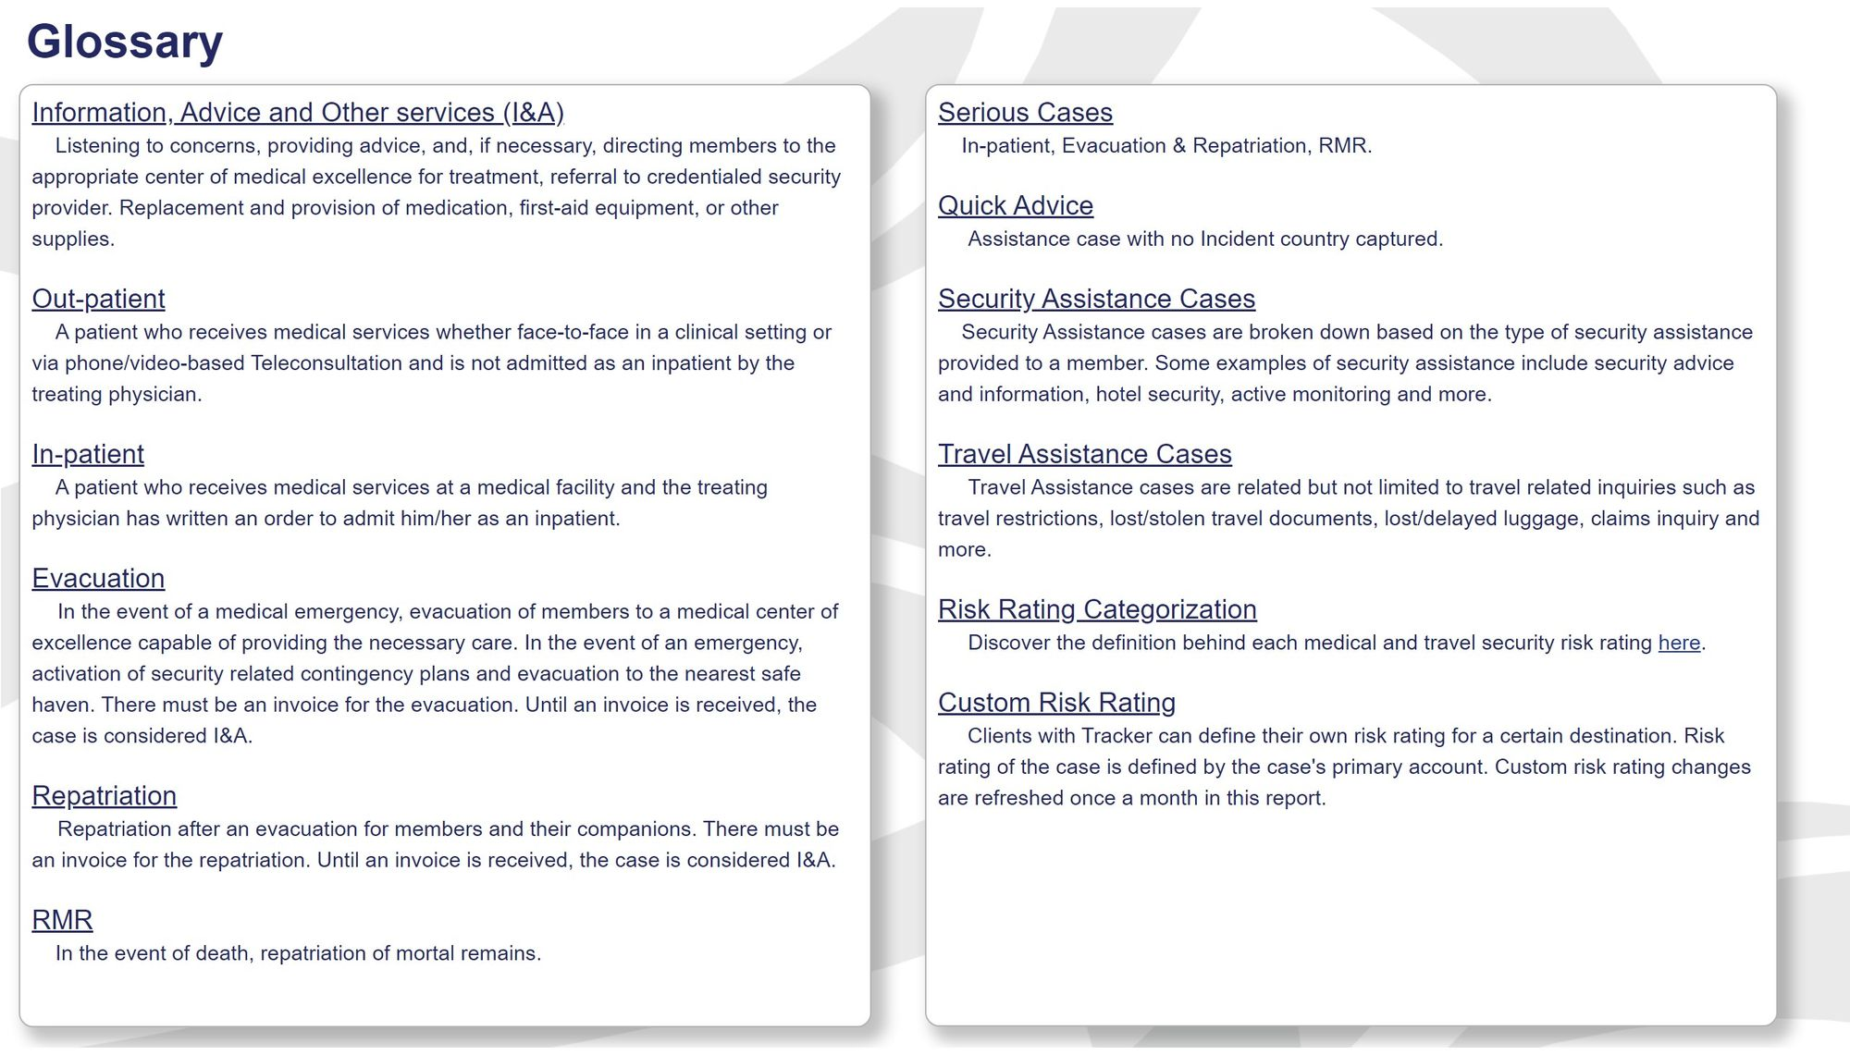

Slide 13
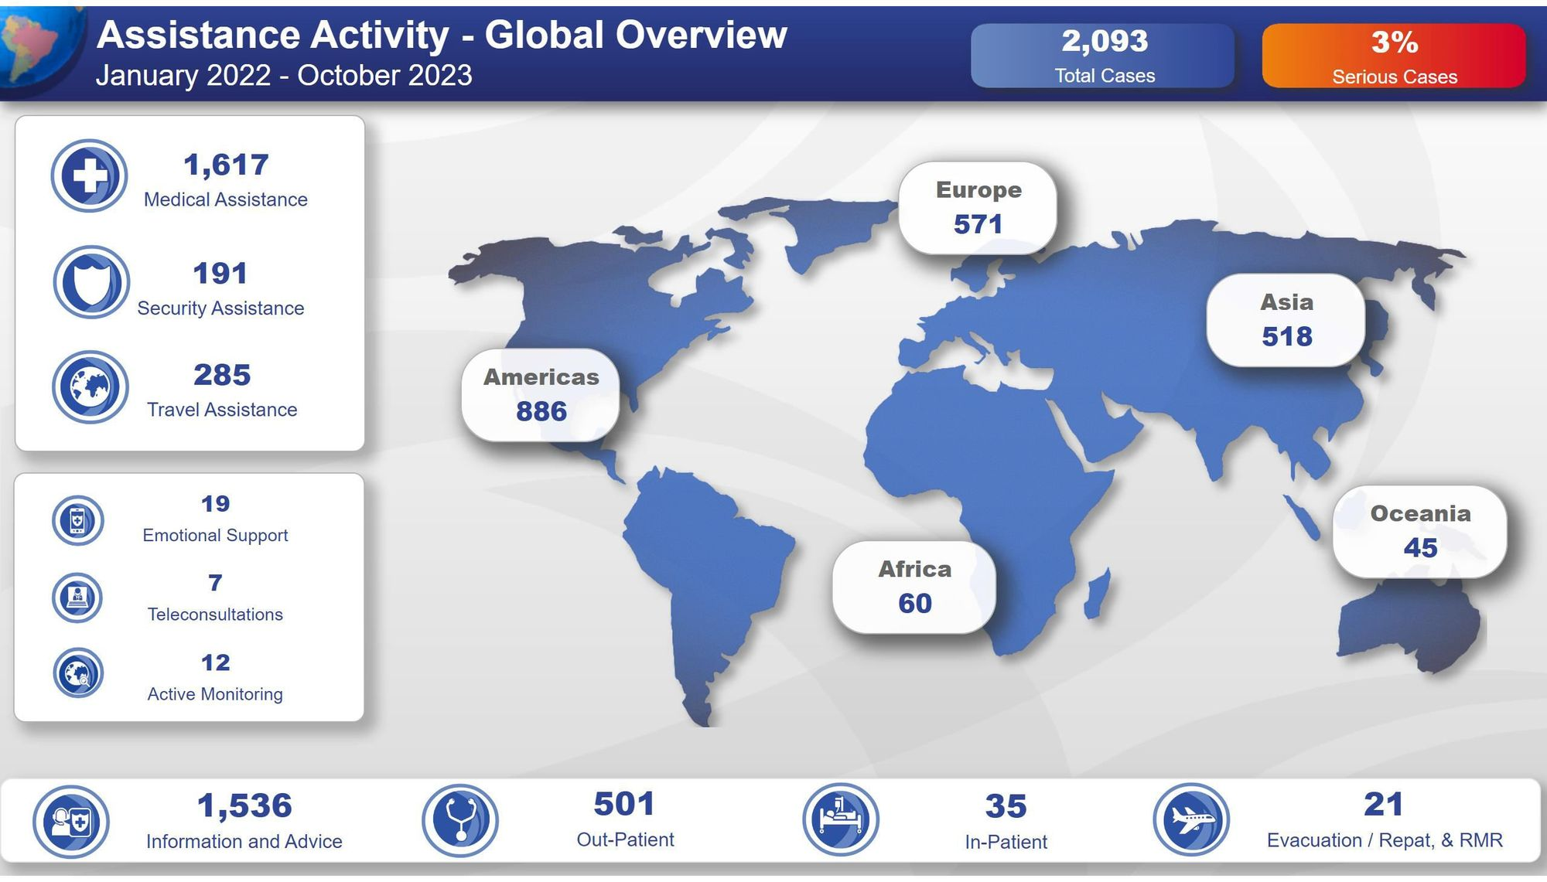

Slide 14
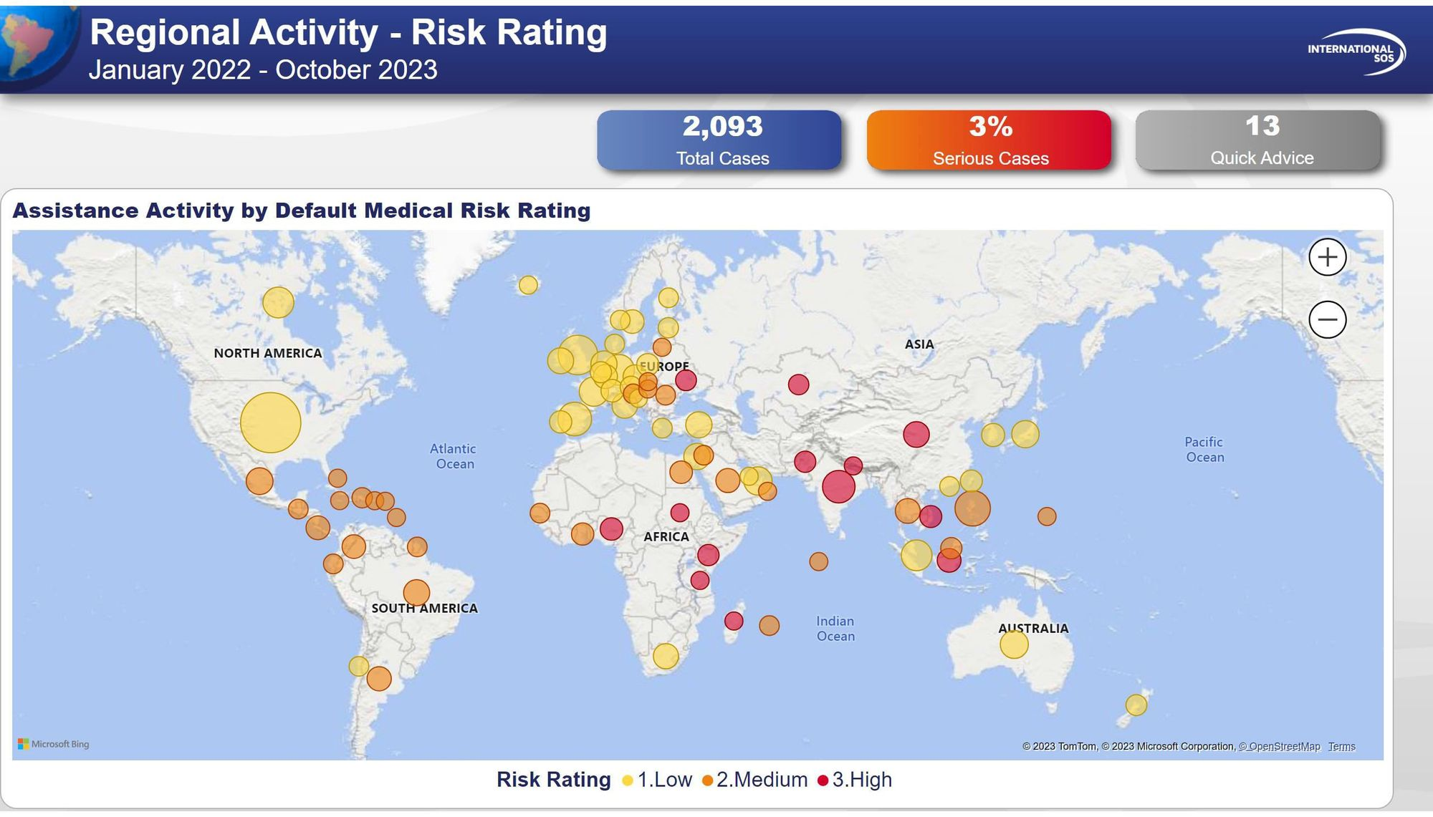

Slide 15
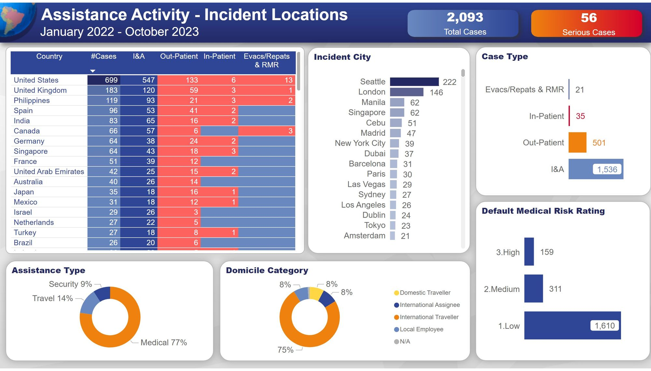

Slide 16
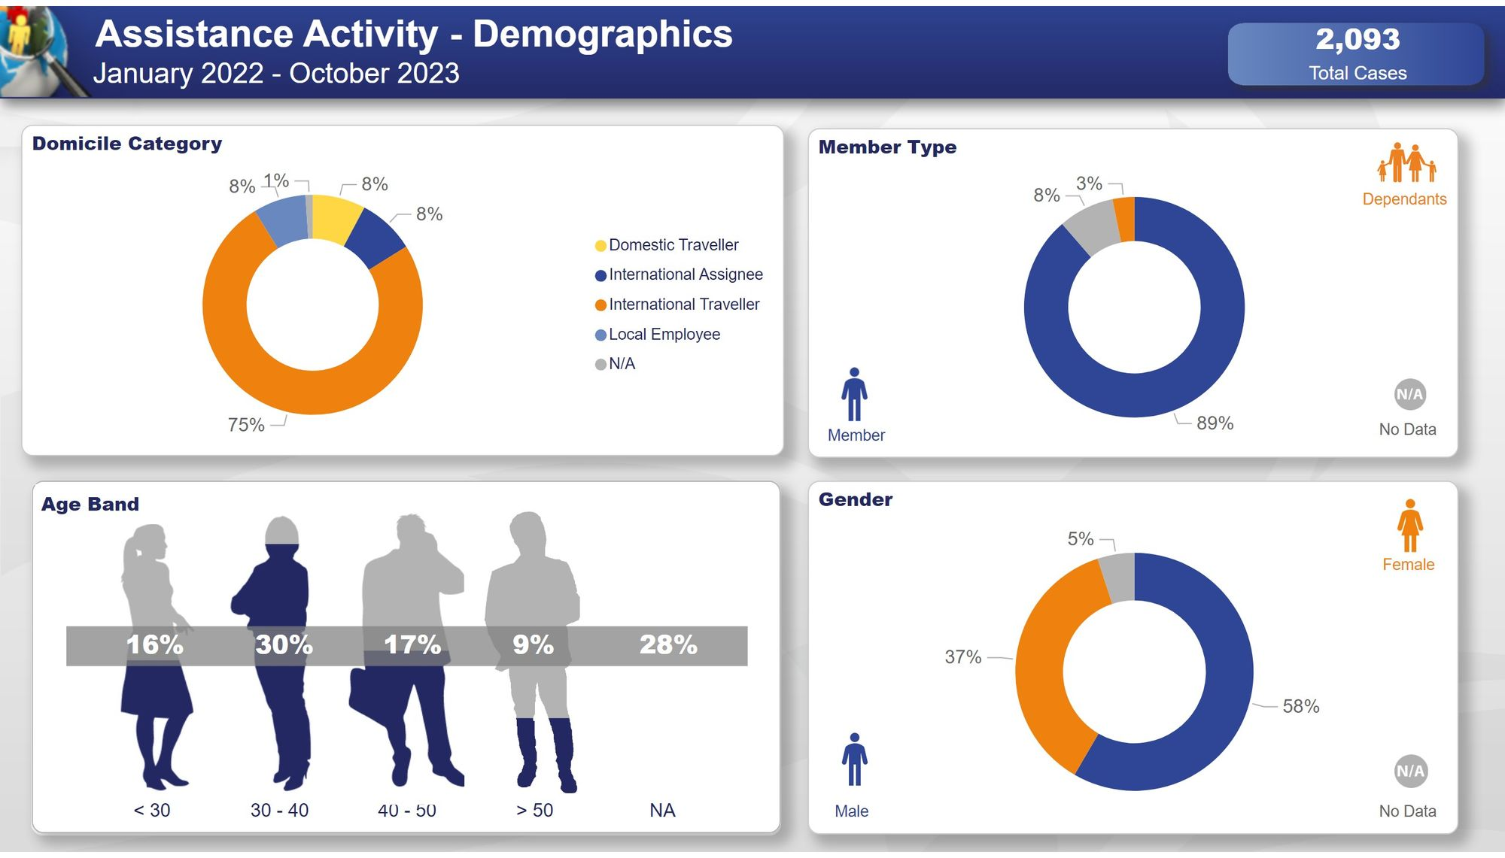

Slide 17
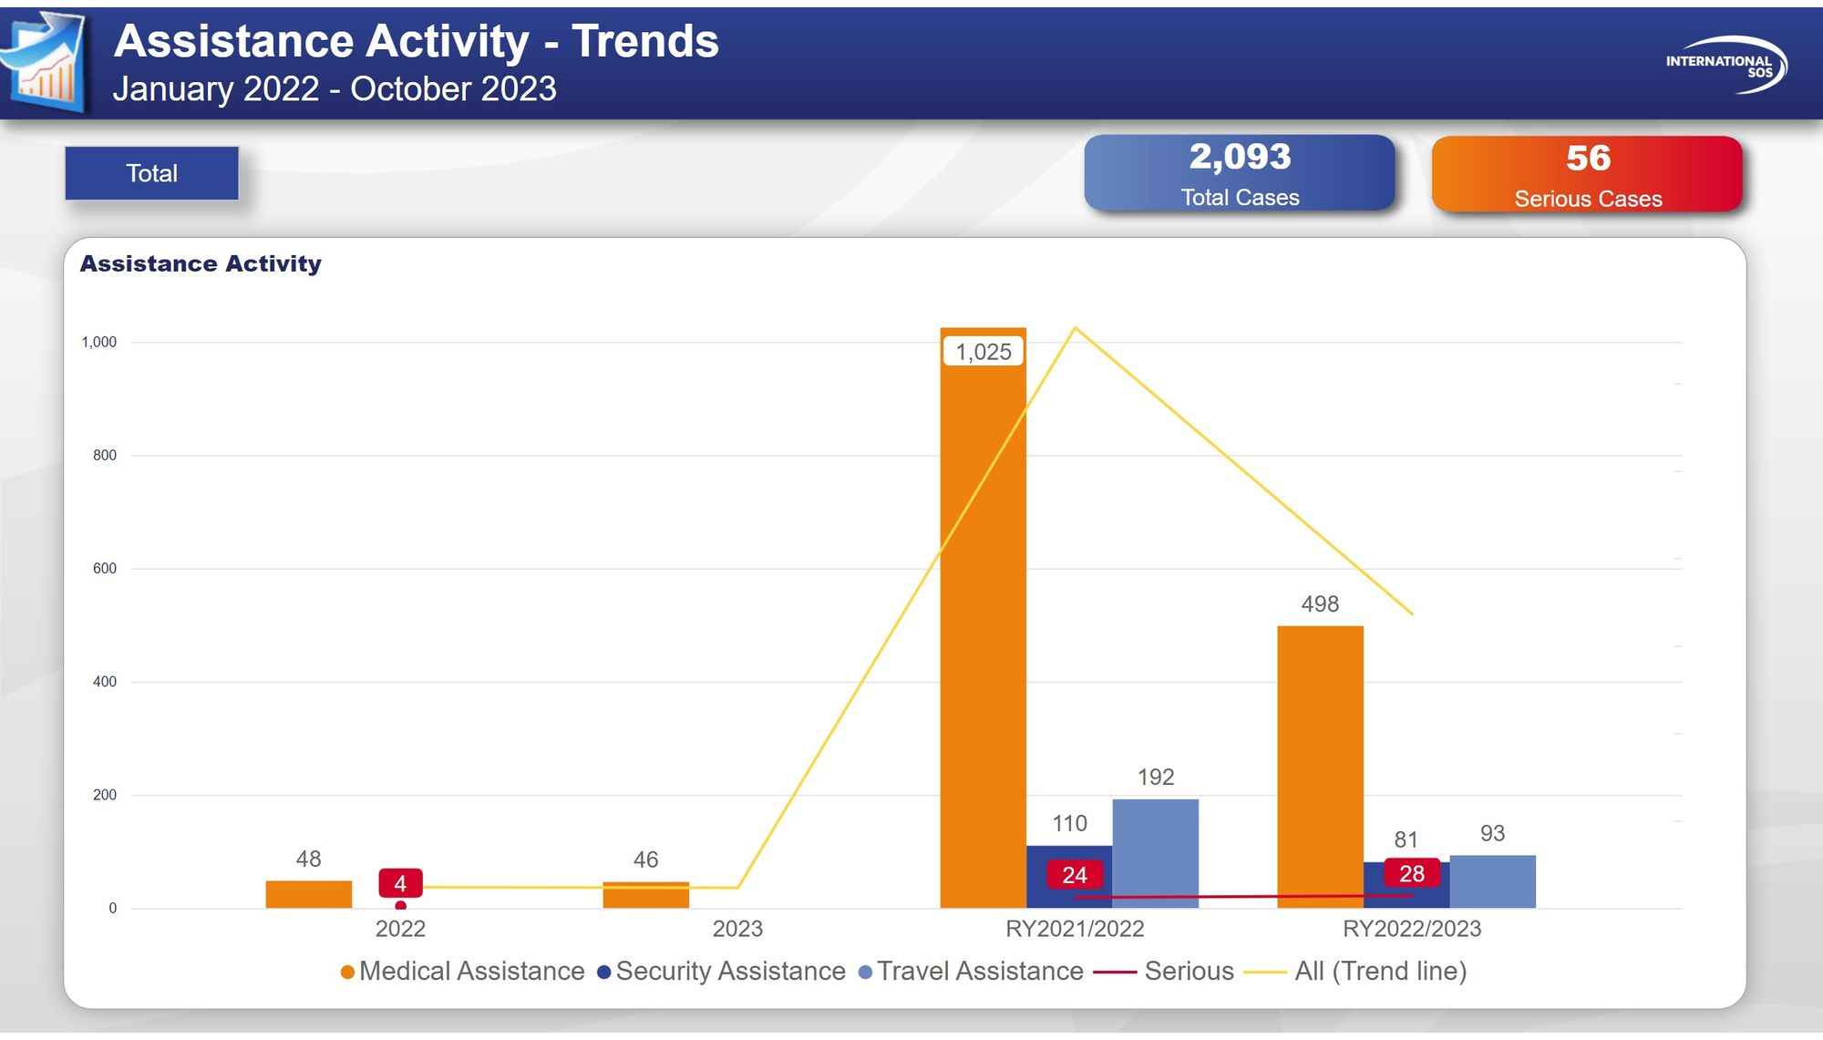

Slide 18
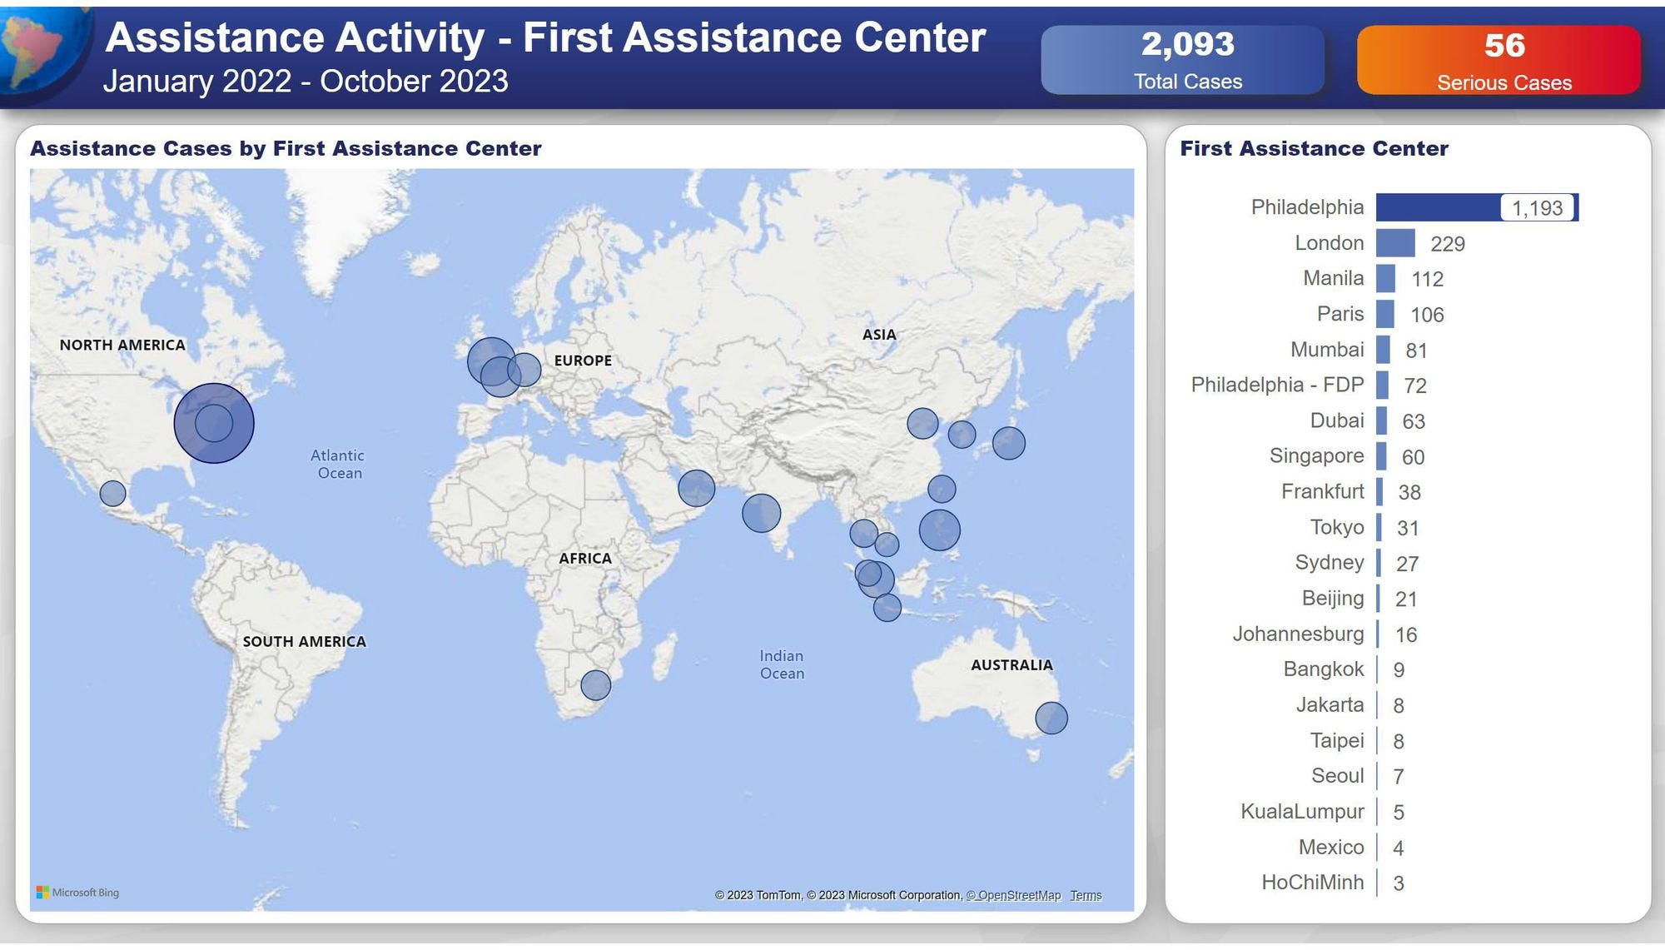

Slide 19
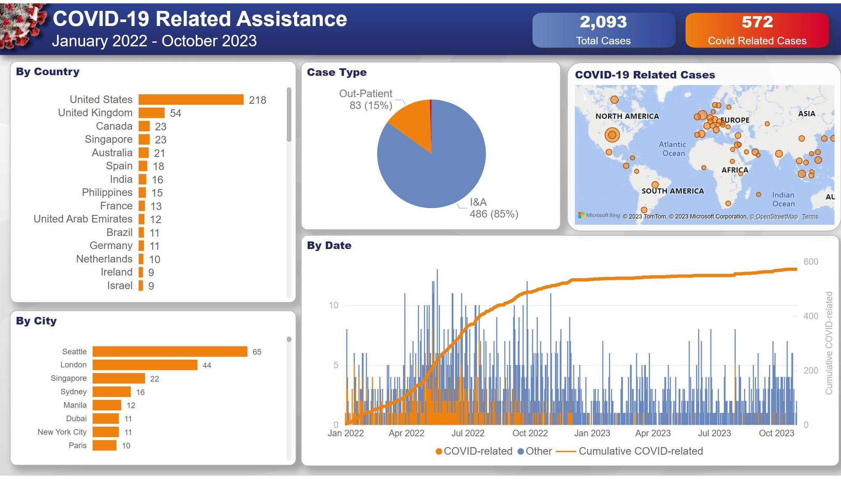

Slide 20
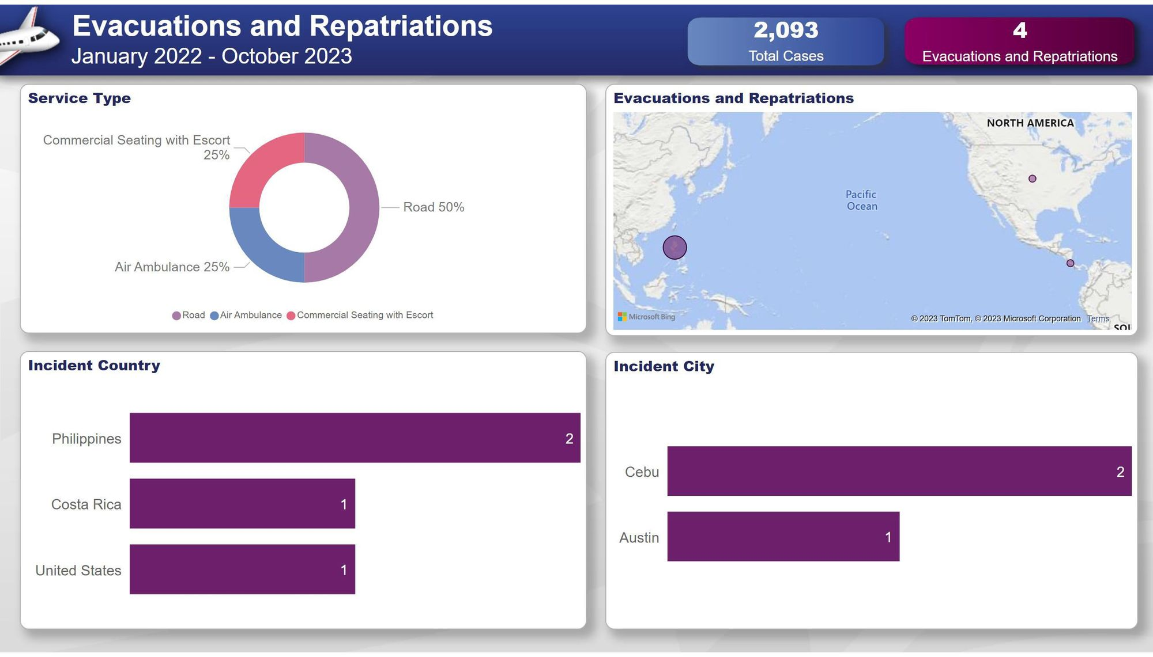

Slide 21
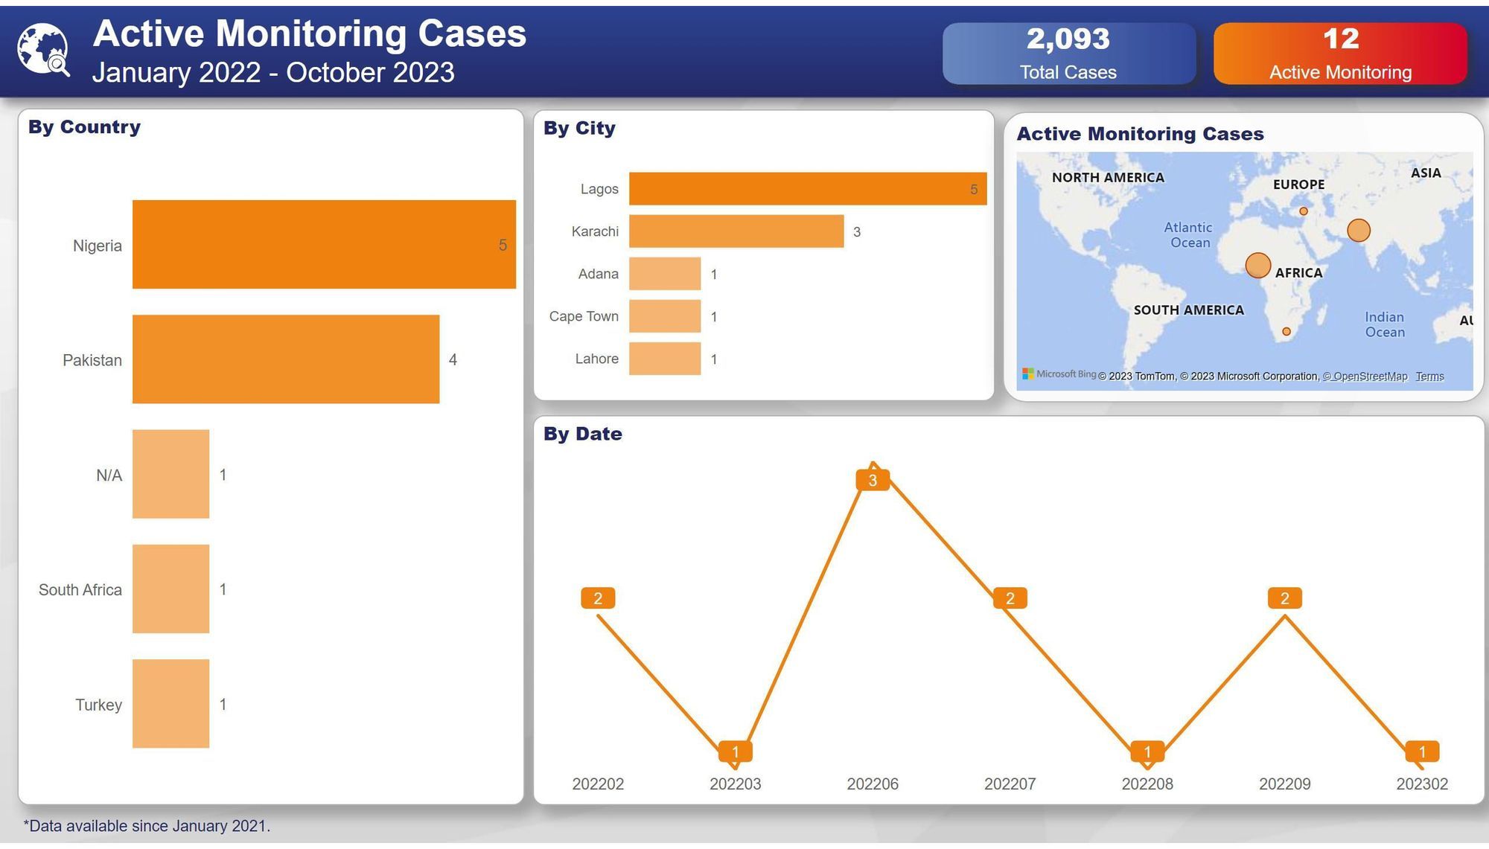

Slide 22
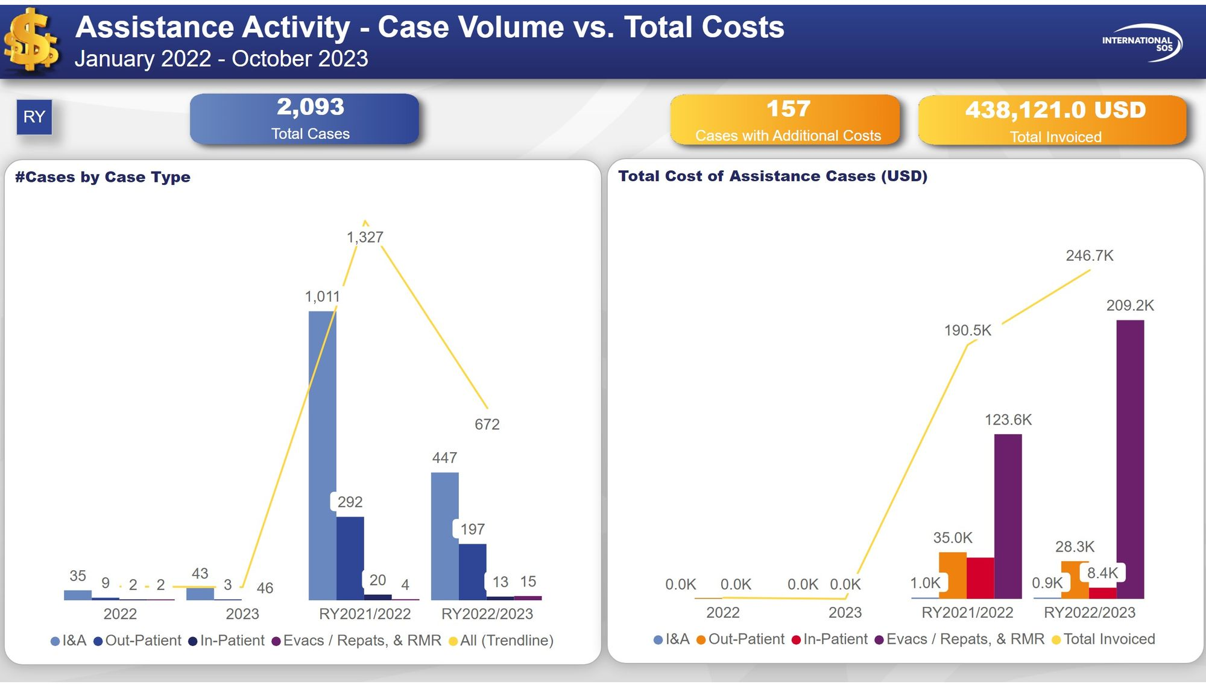

Slide 23
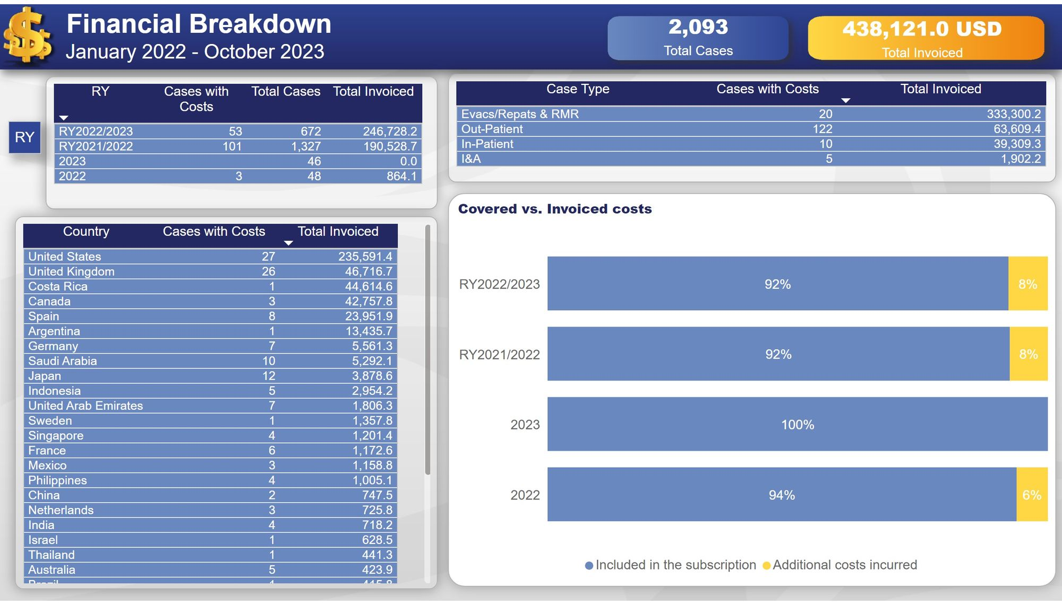

Slide 24
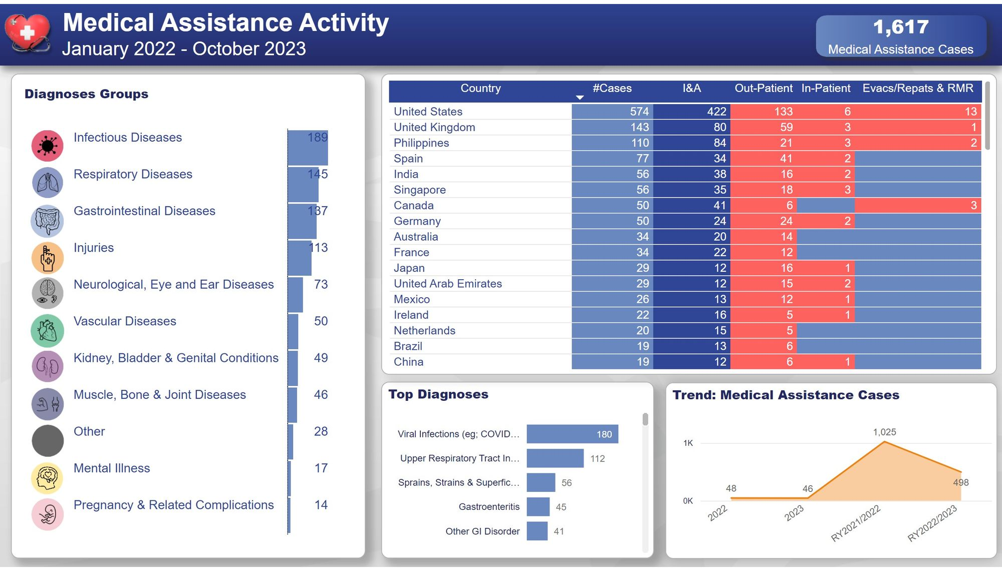

Slide 25
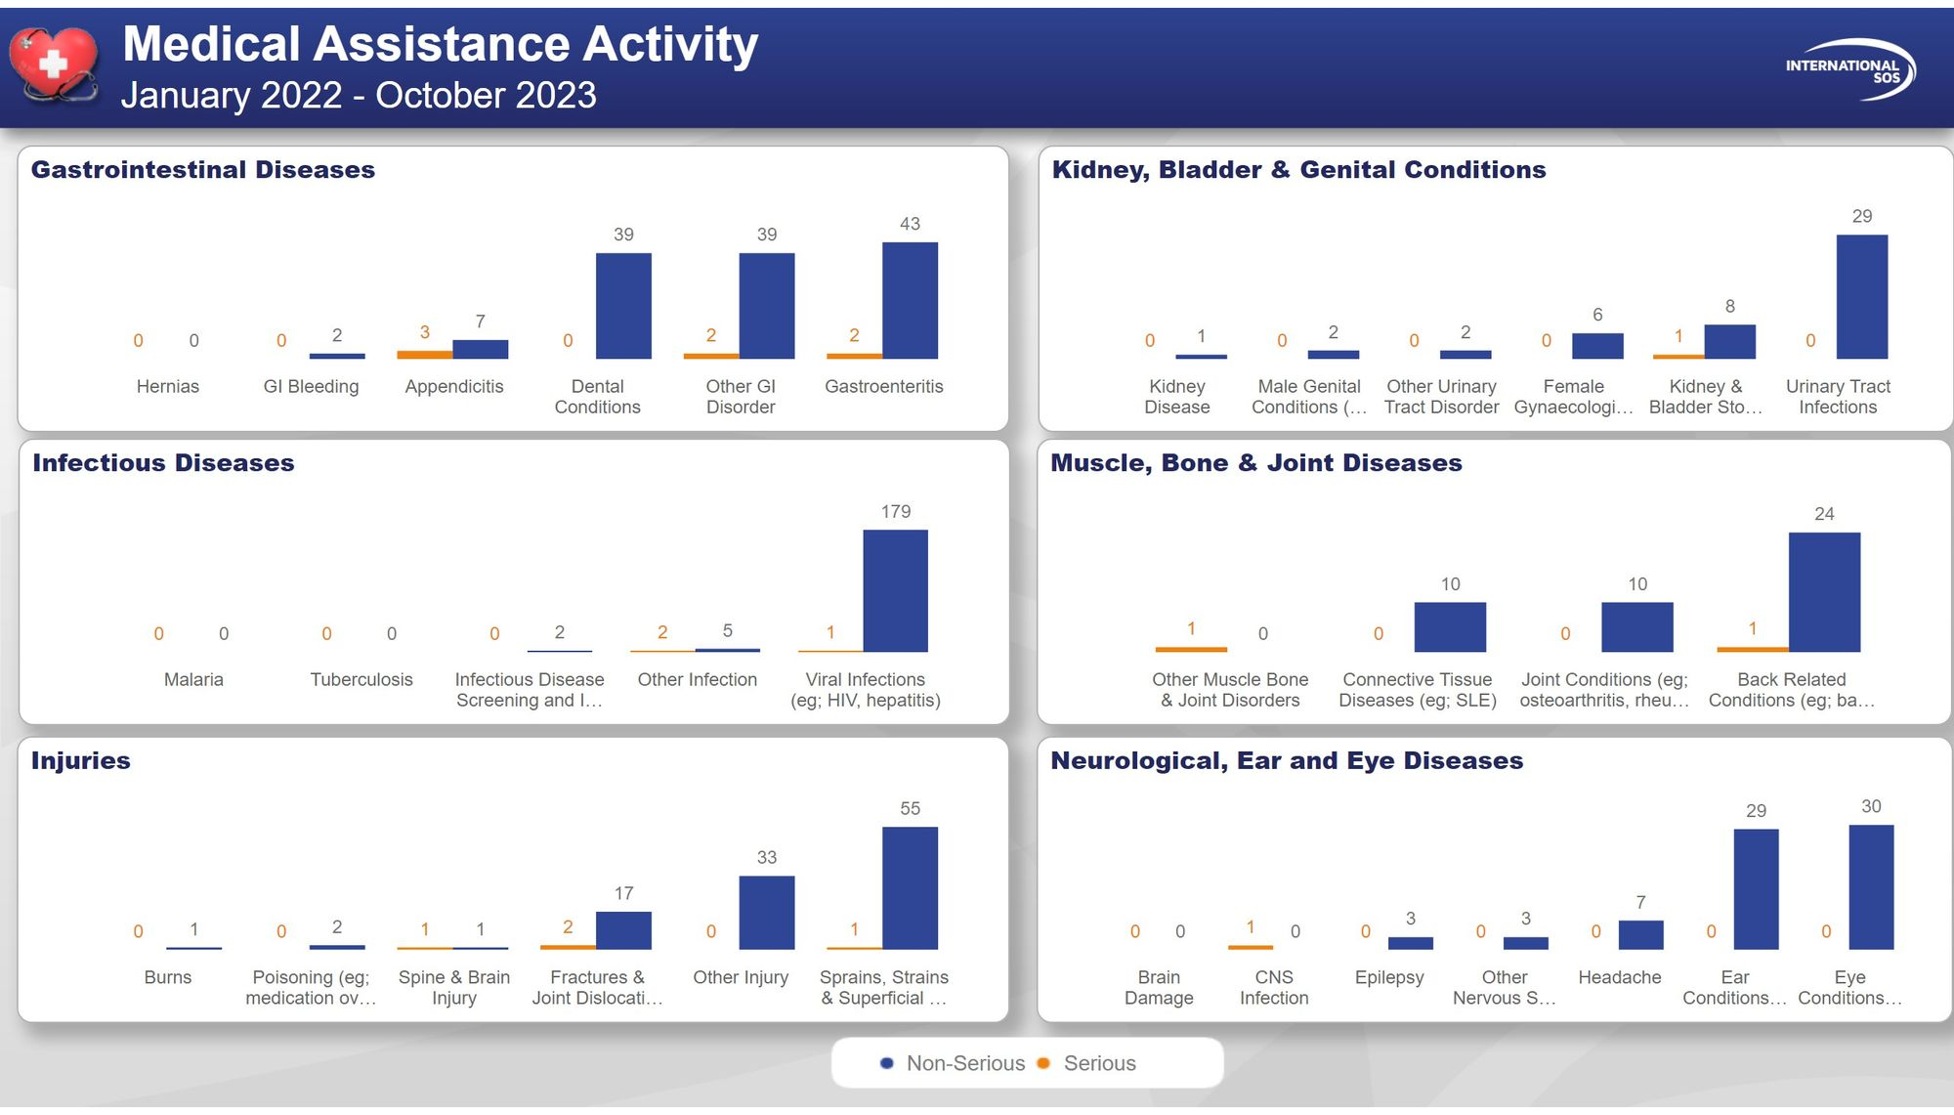

Slide 26
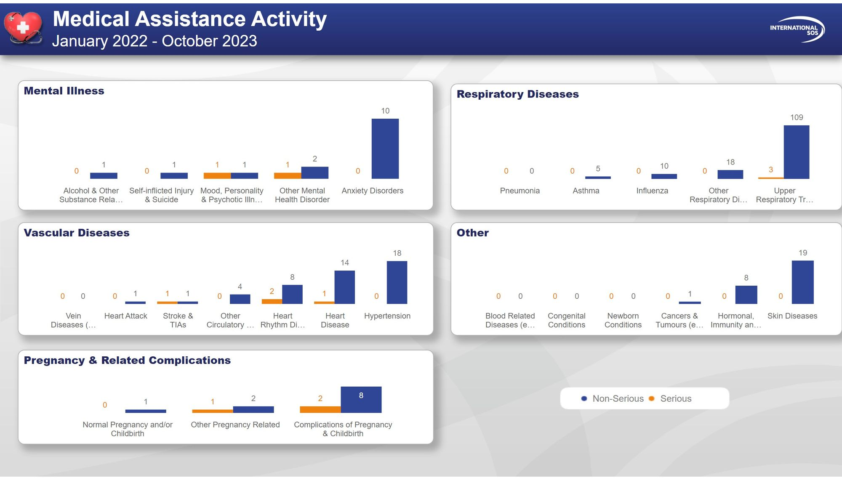

Slide 27


Slide 28
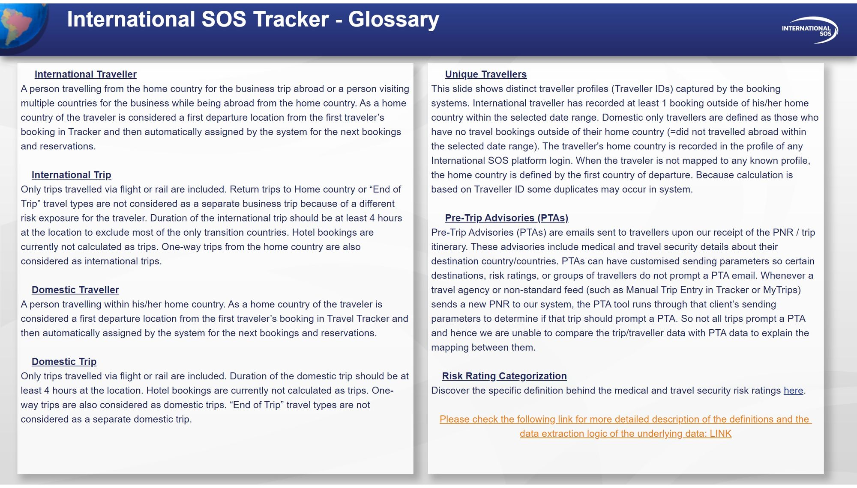

Slide 29
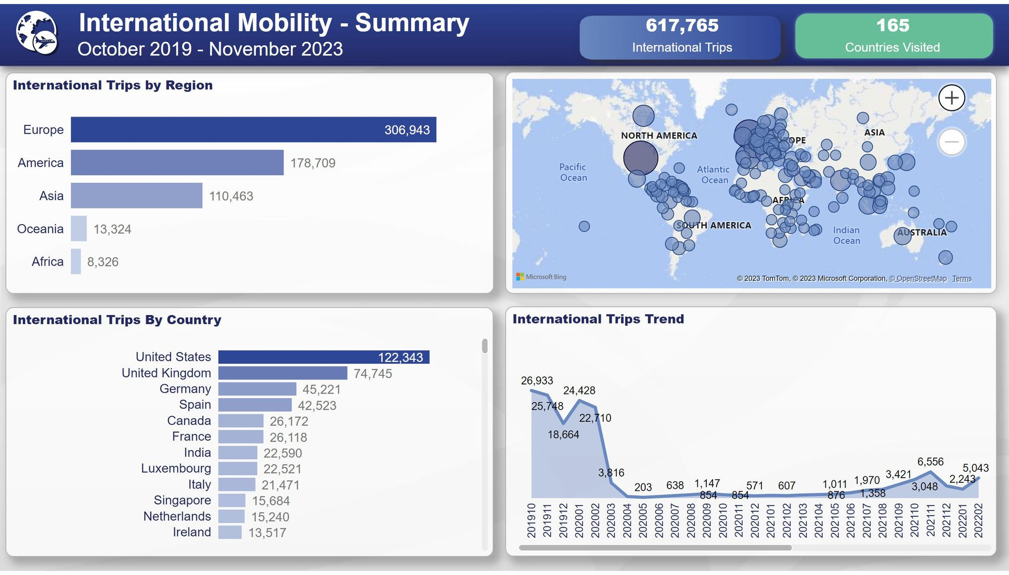

Slide 30
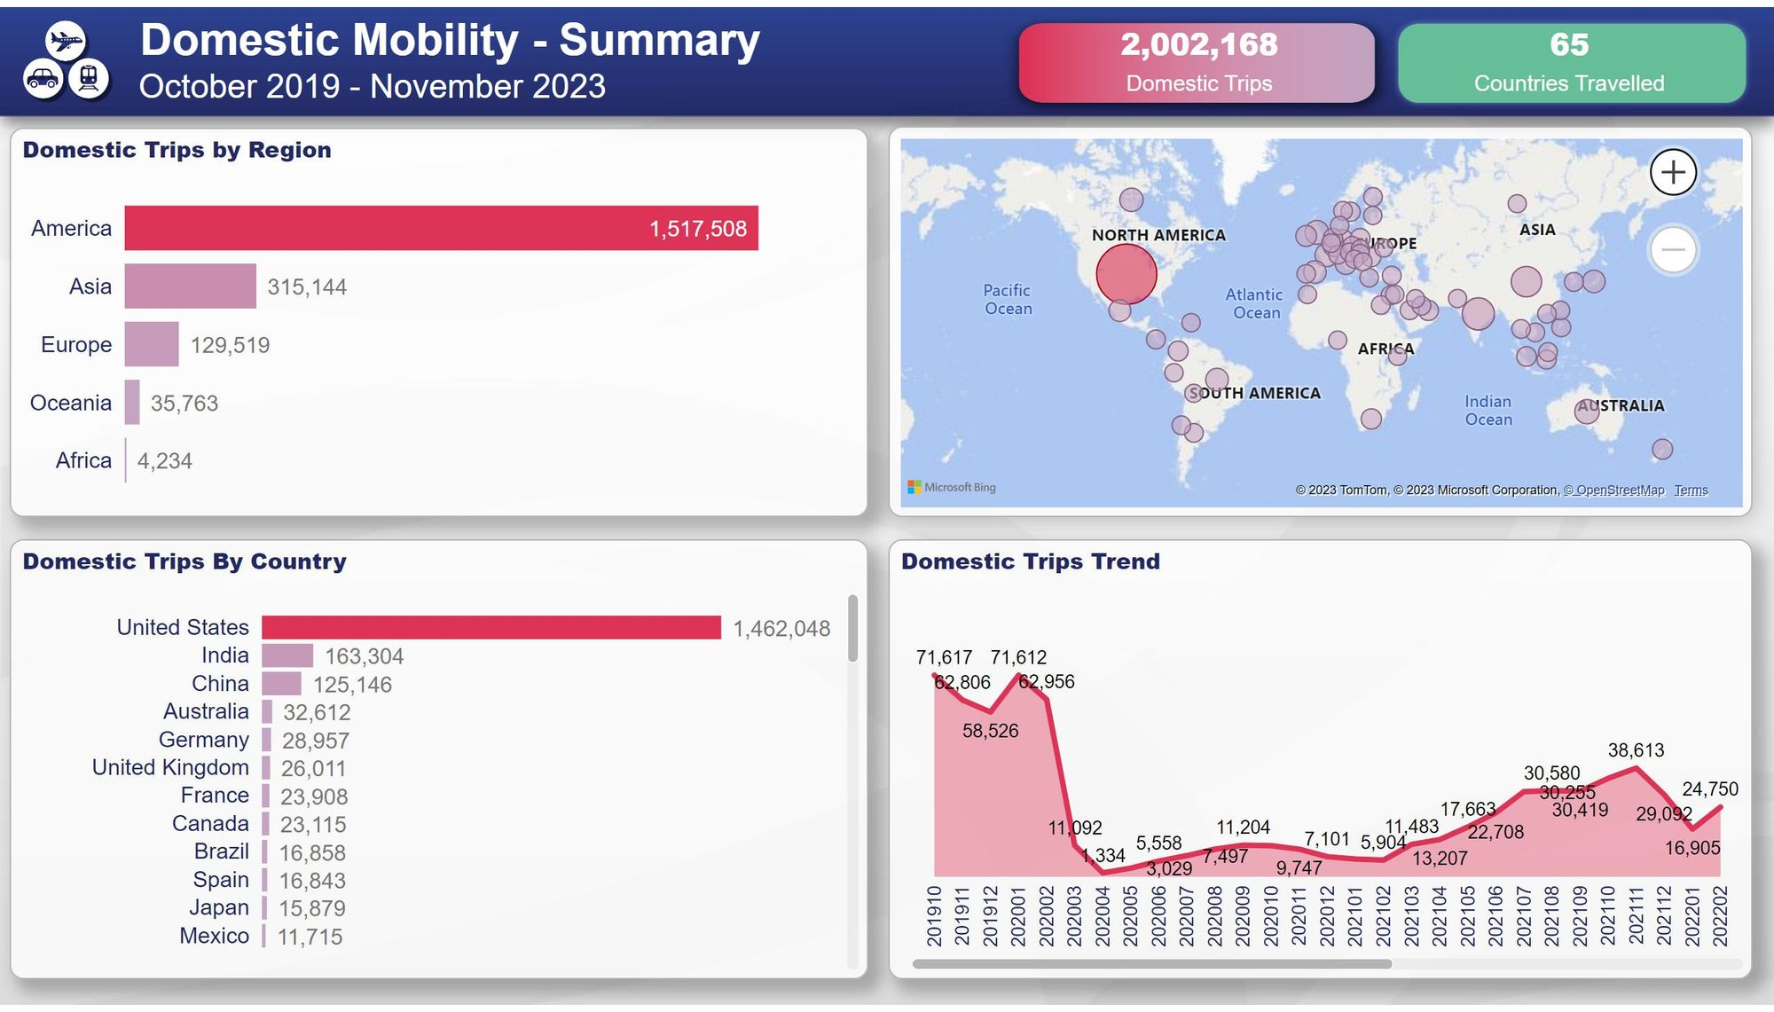

Slide 31
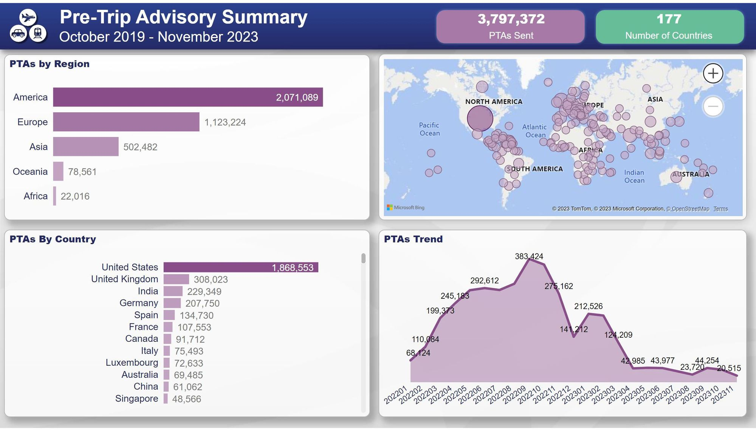

Slide 32
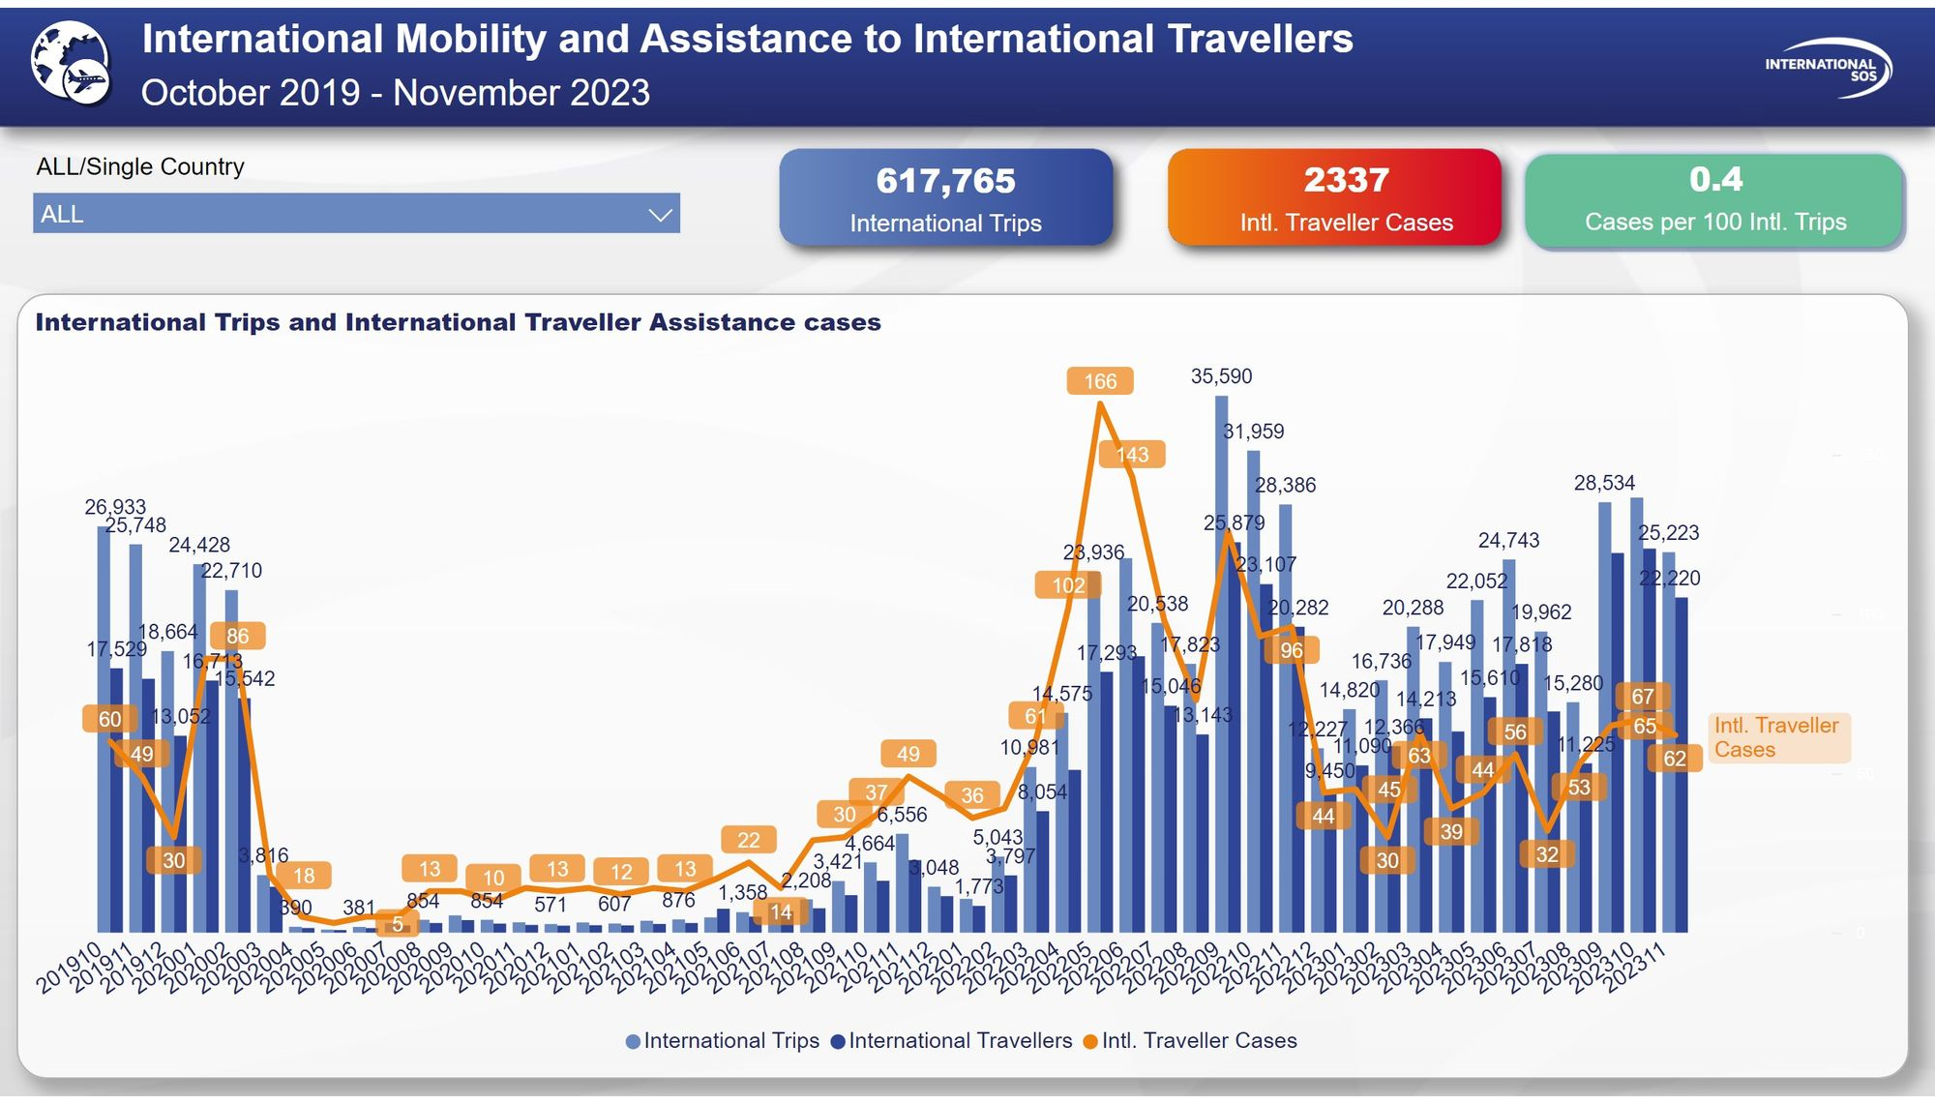

Slide 33
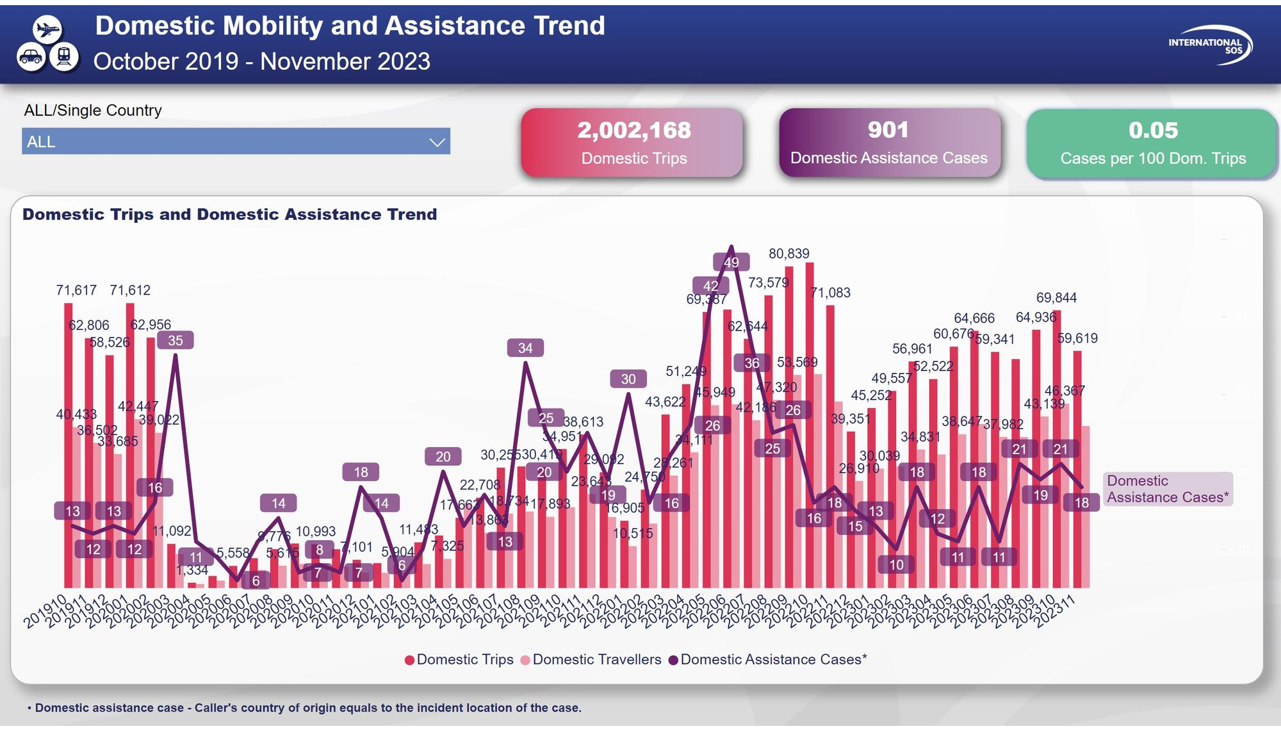

Slide 34
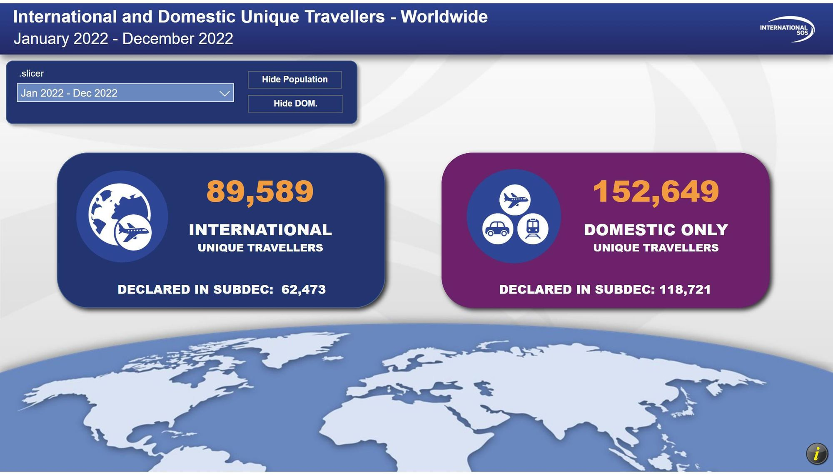

Slide 35
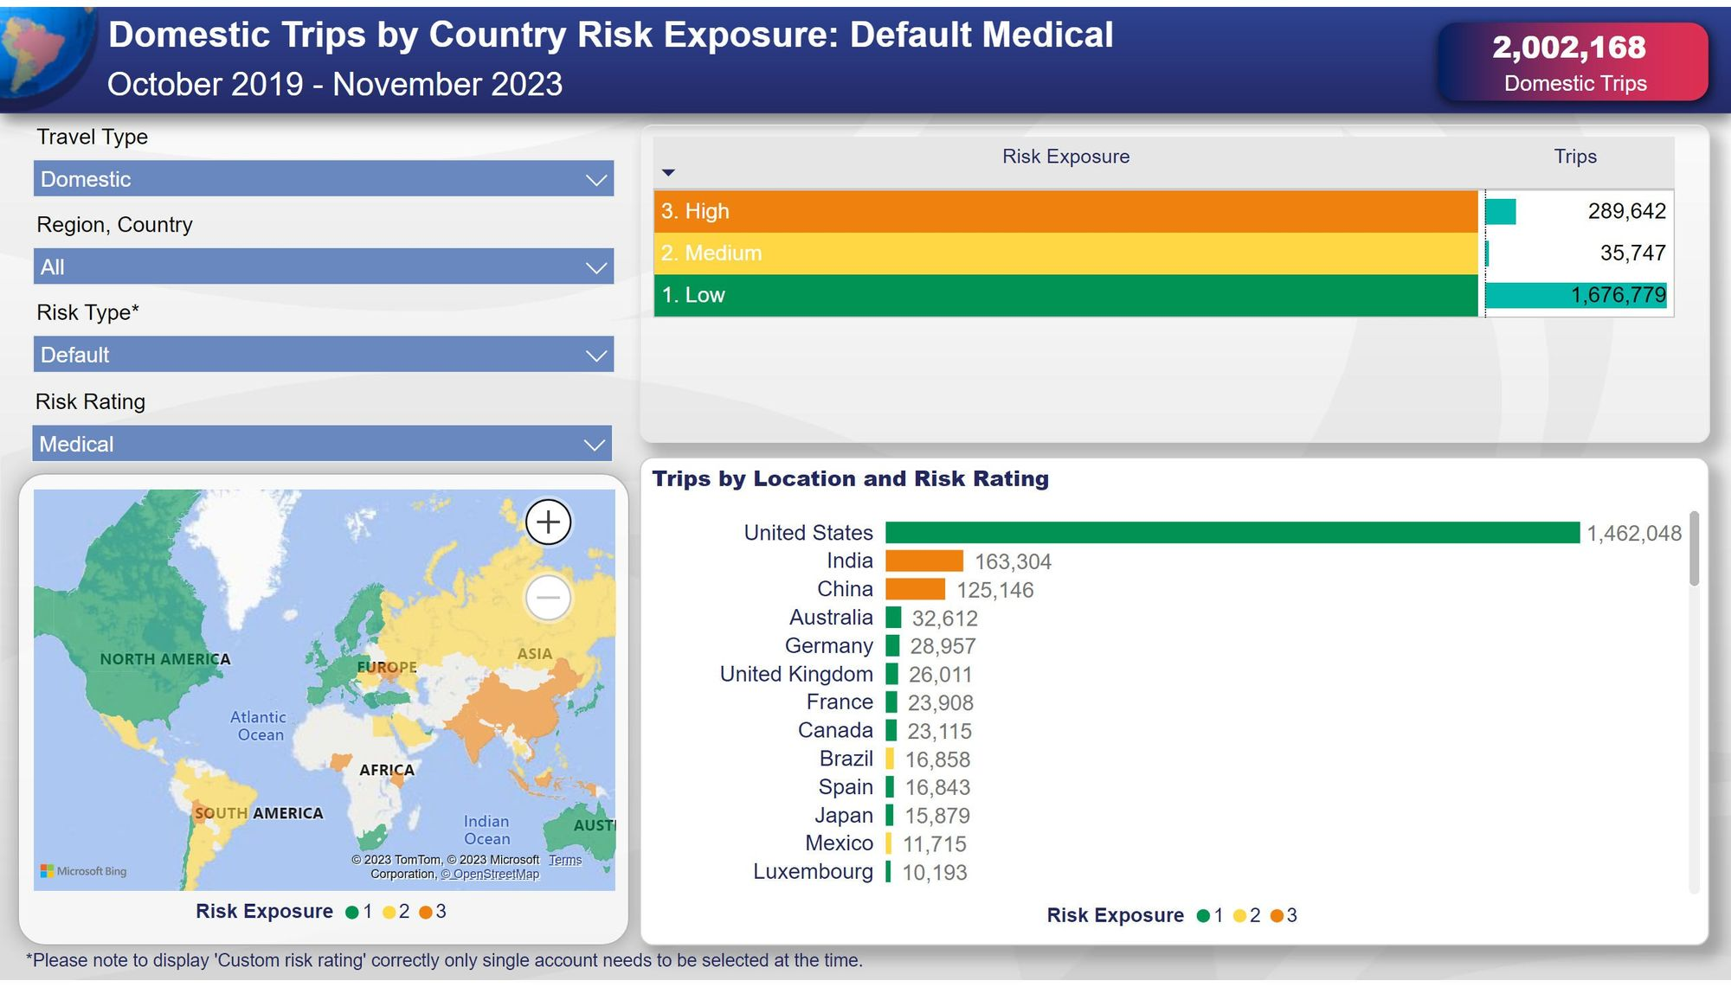

Slide 36
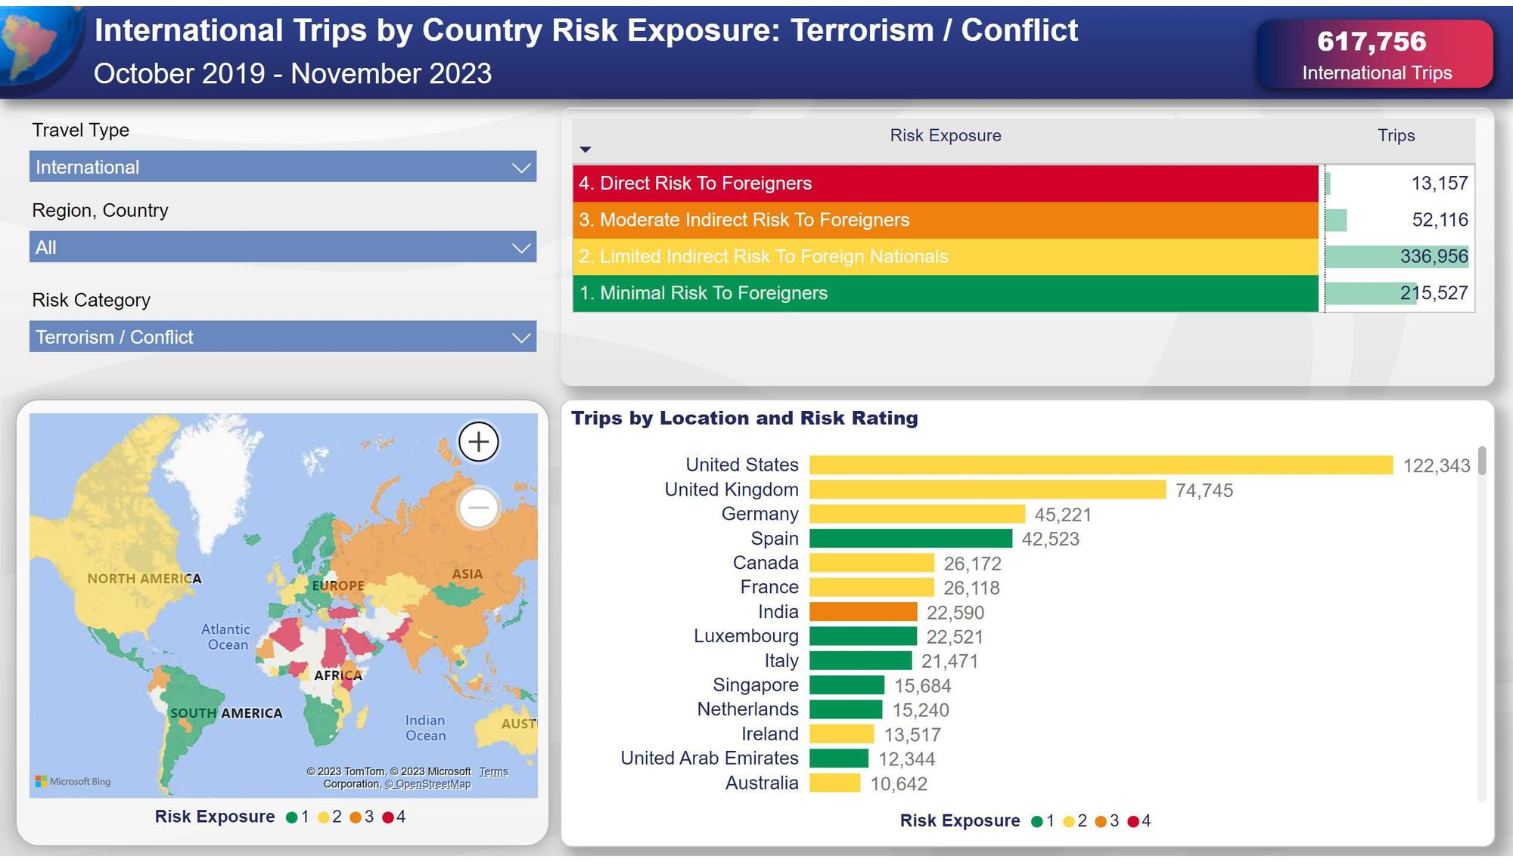

Slide 37
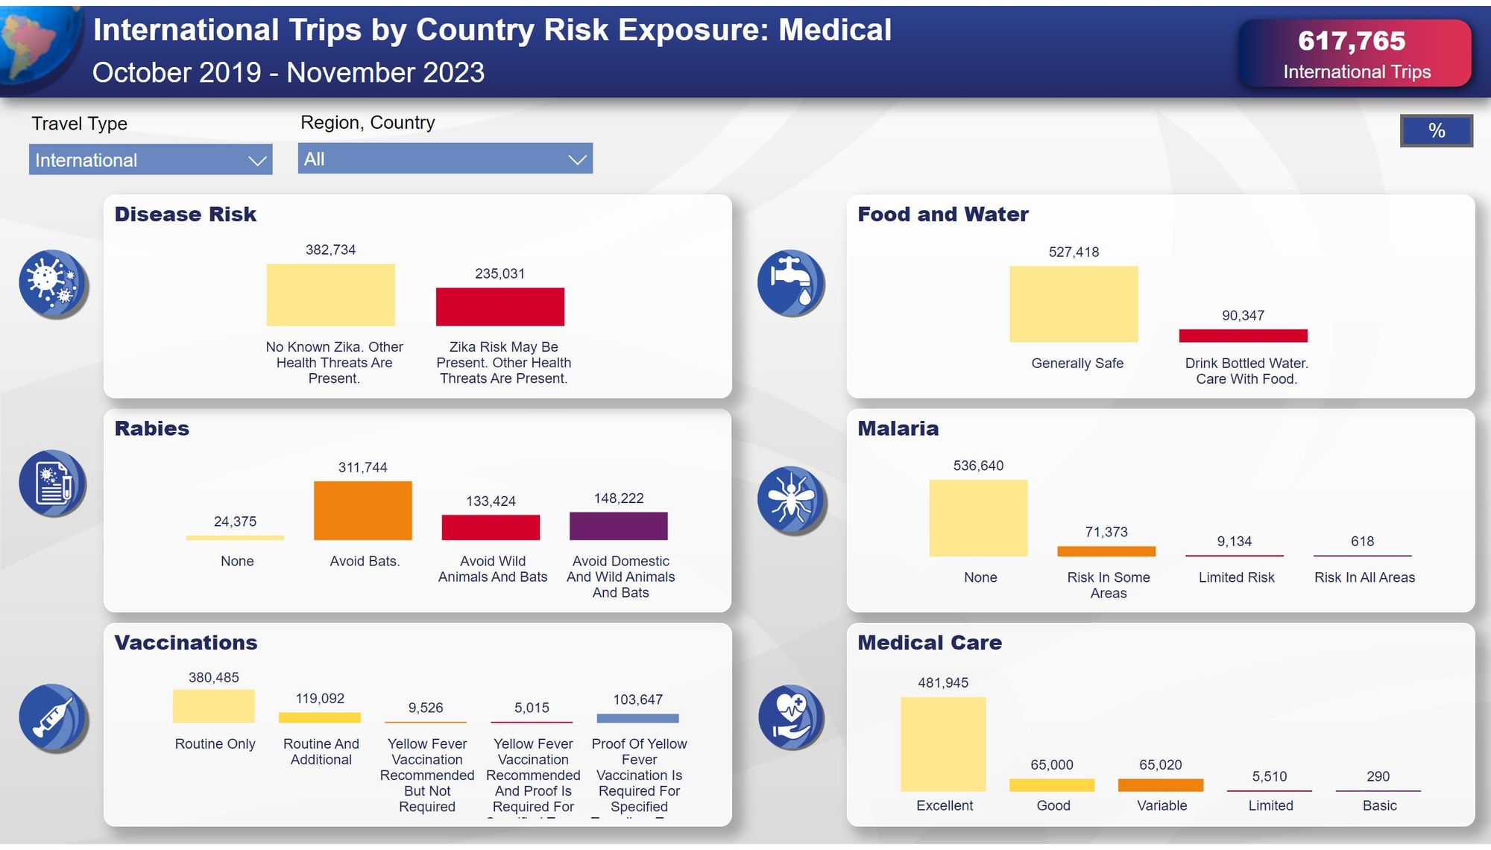

Slide 38
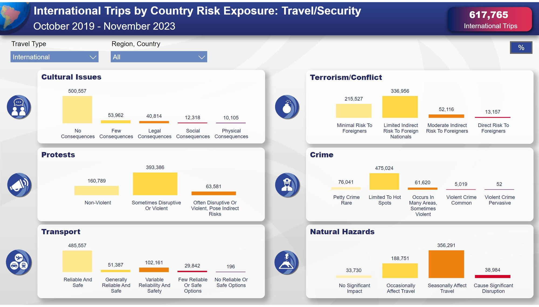

Slide 39
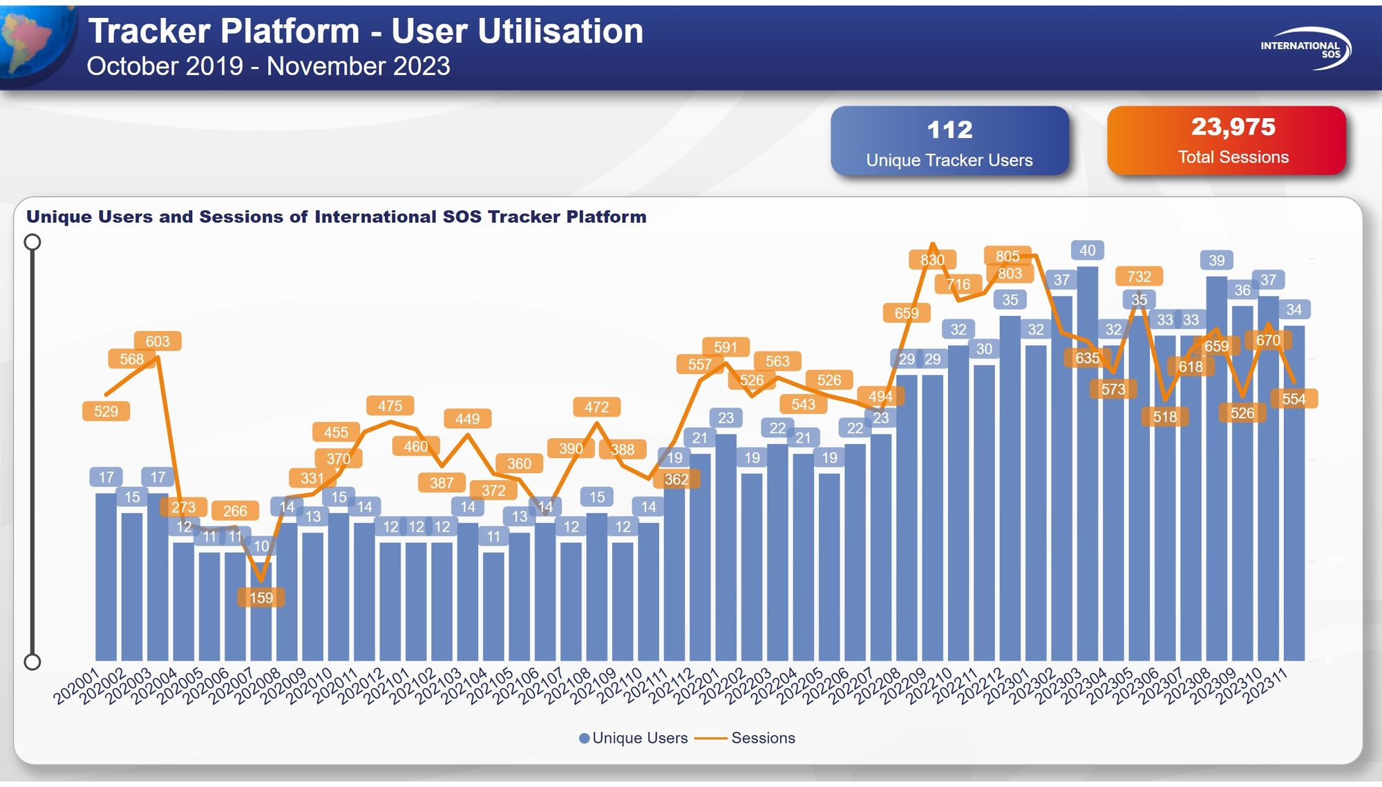

Slide 40
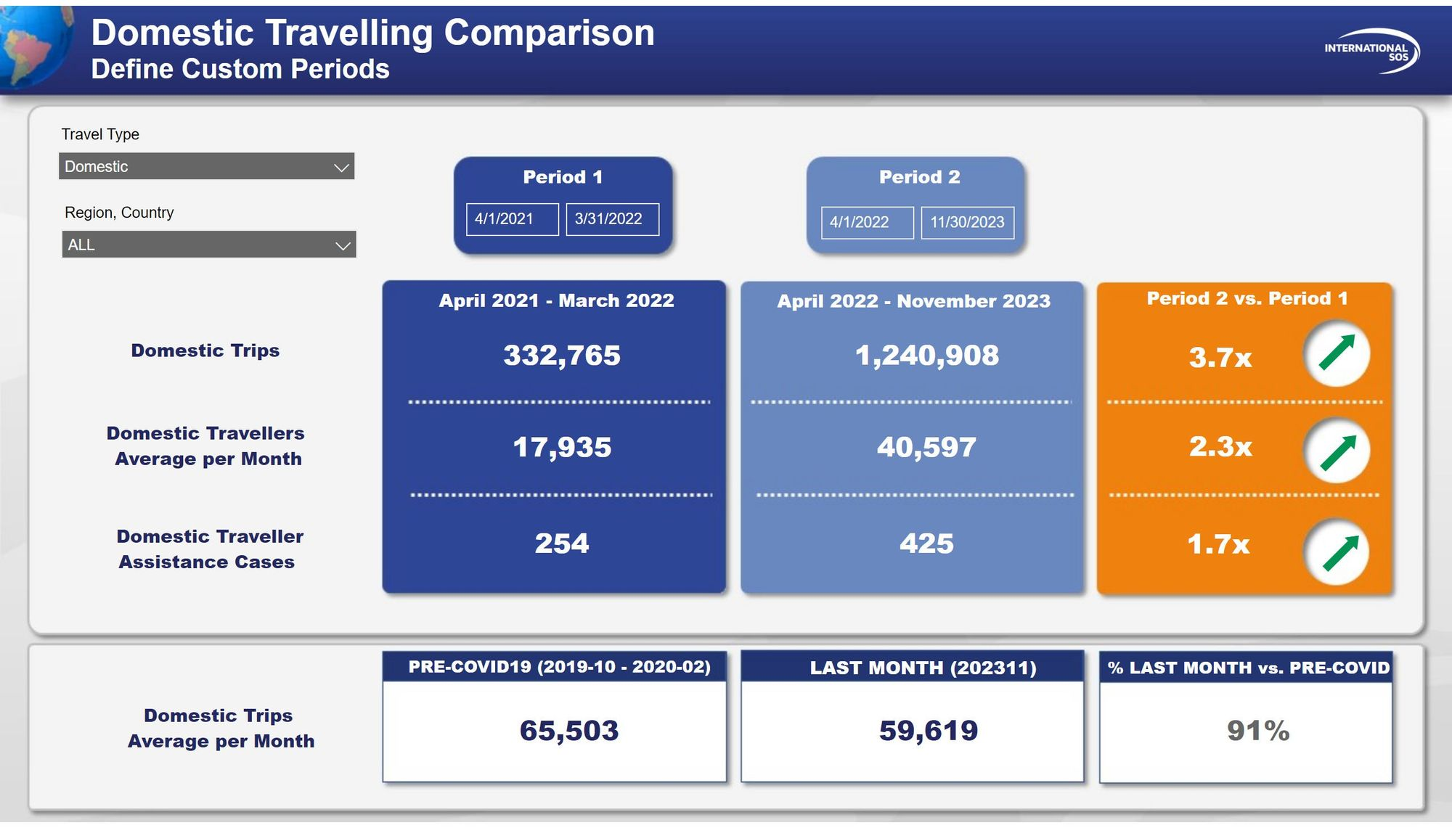

Slide 41
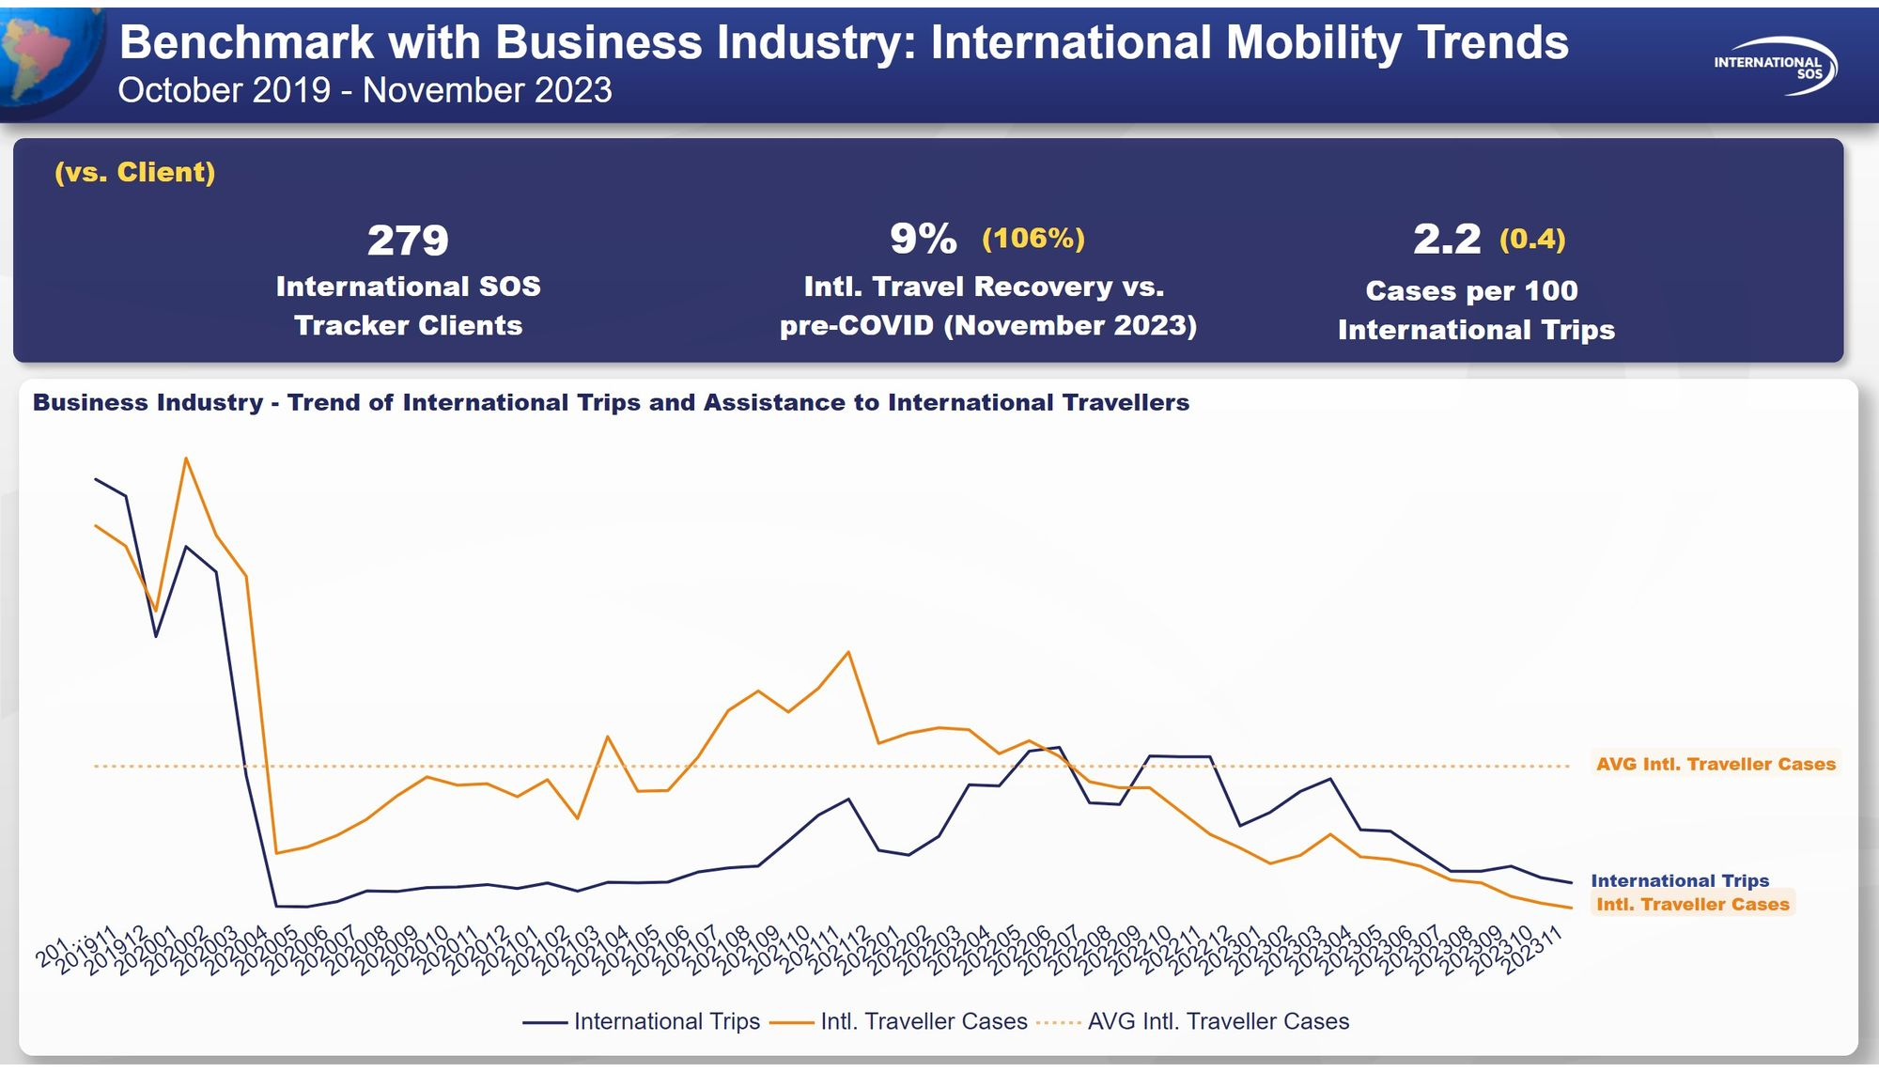

Slide 42
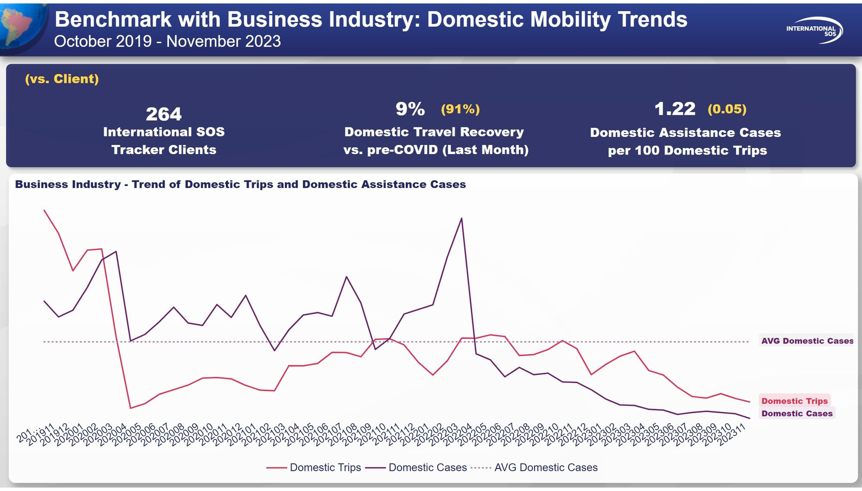

Slide 43


Slide 44
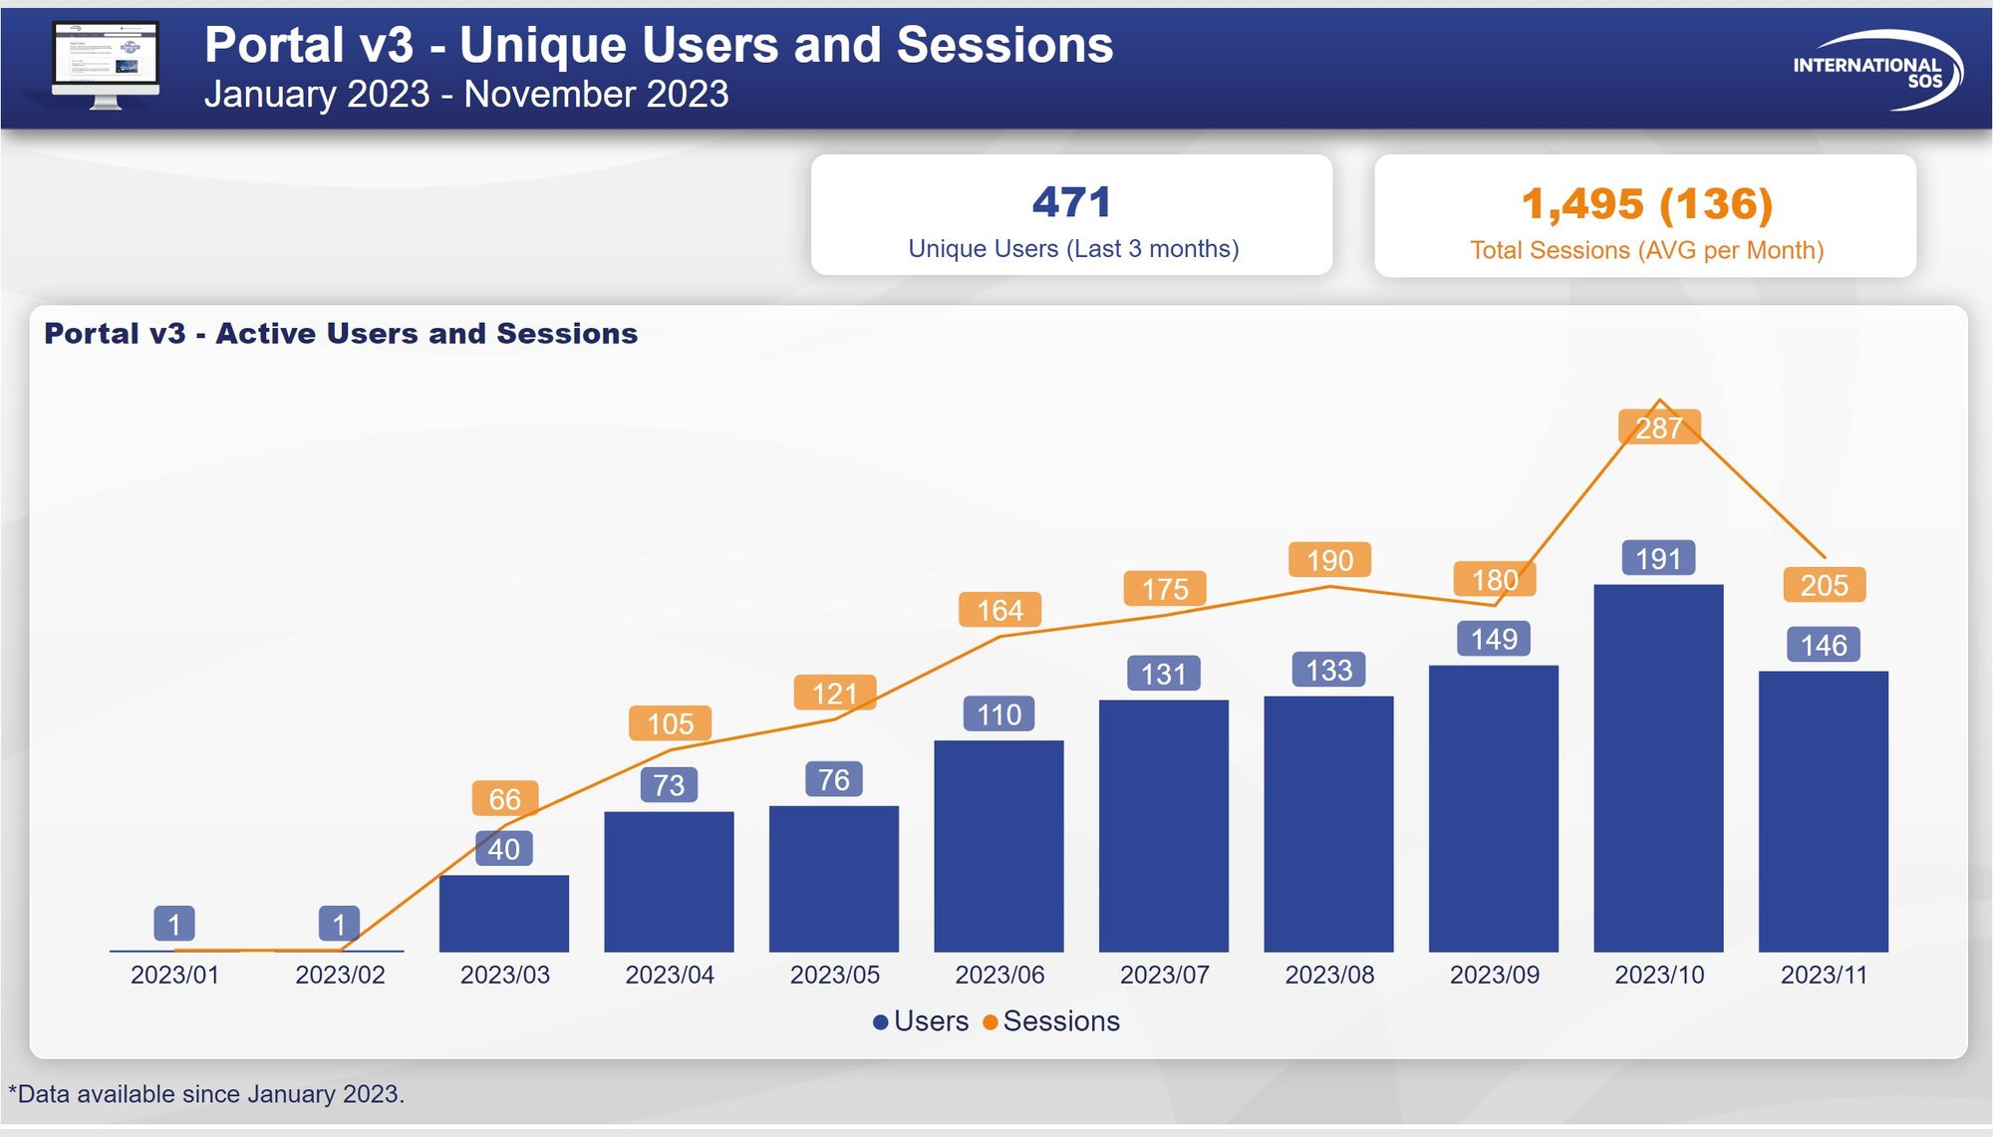

Slide 45
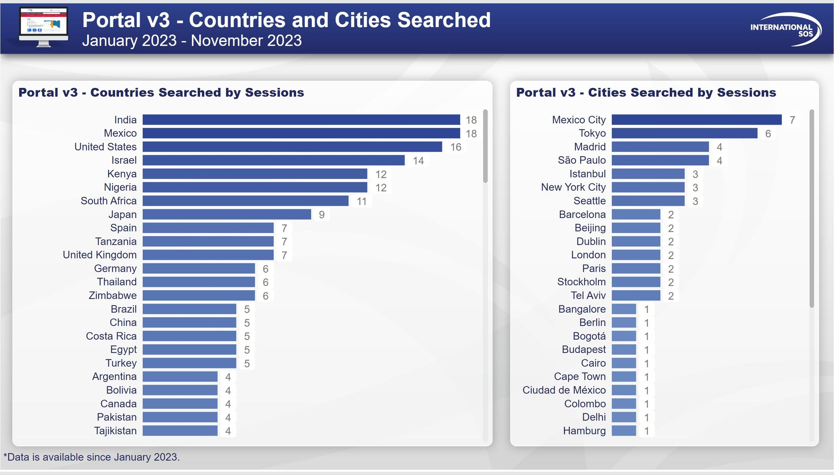

Slide 46
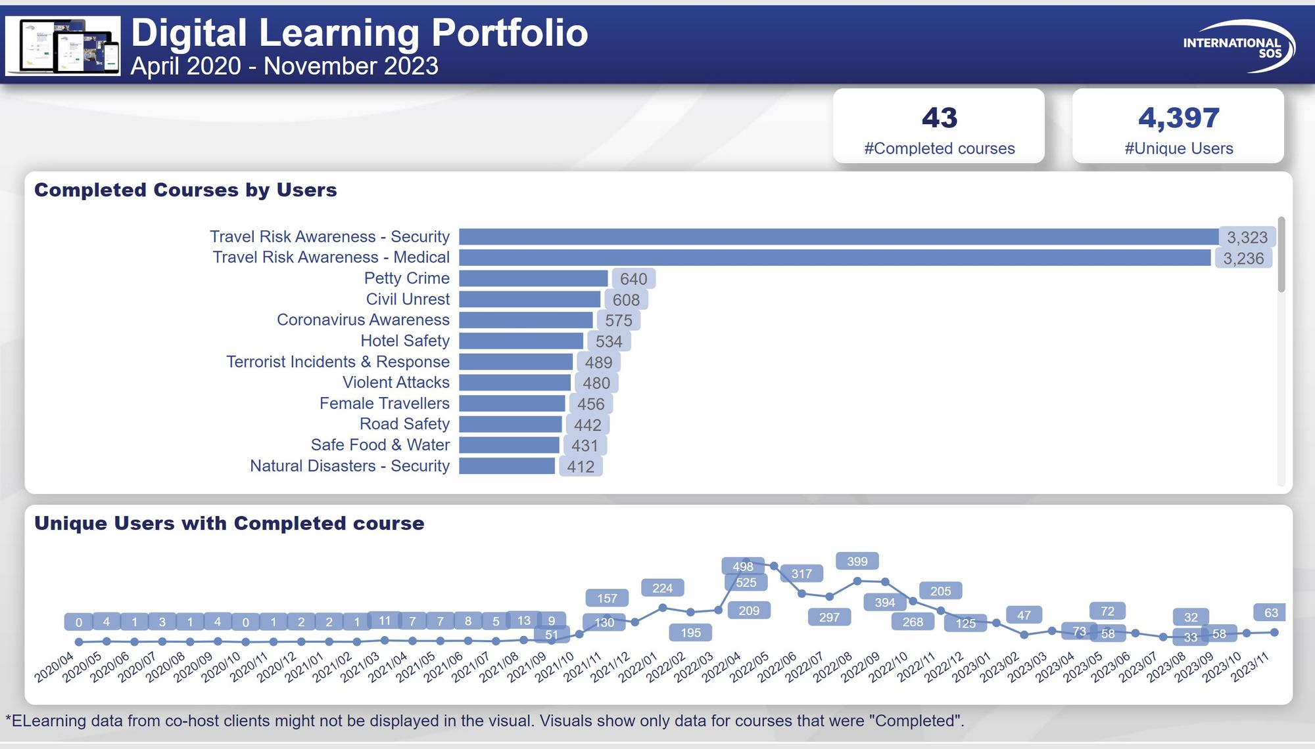

Slide 47
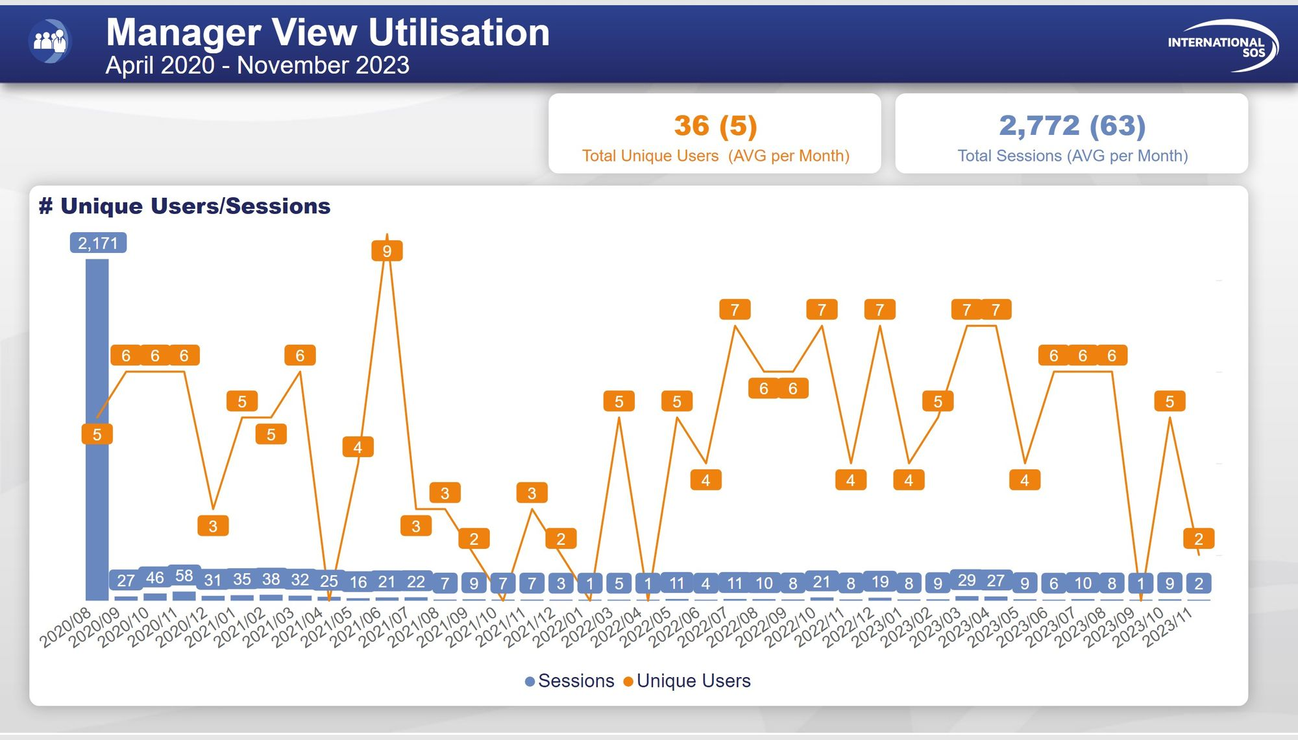

Slide 48
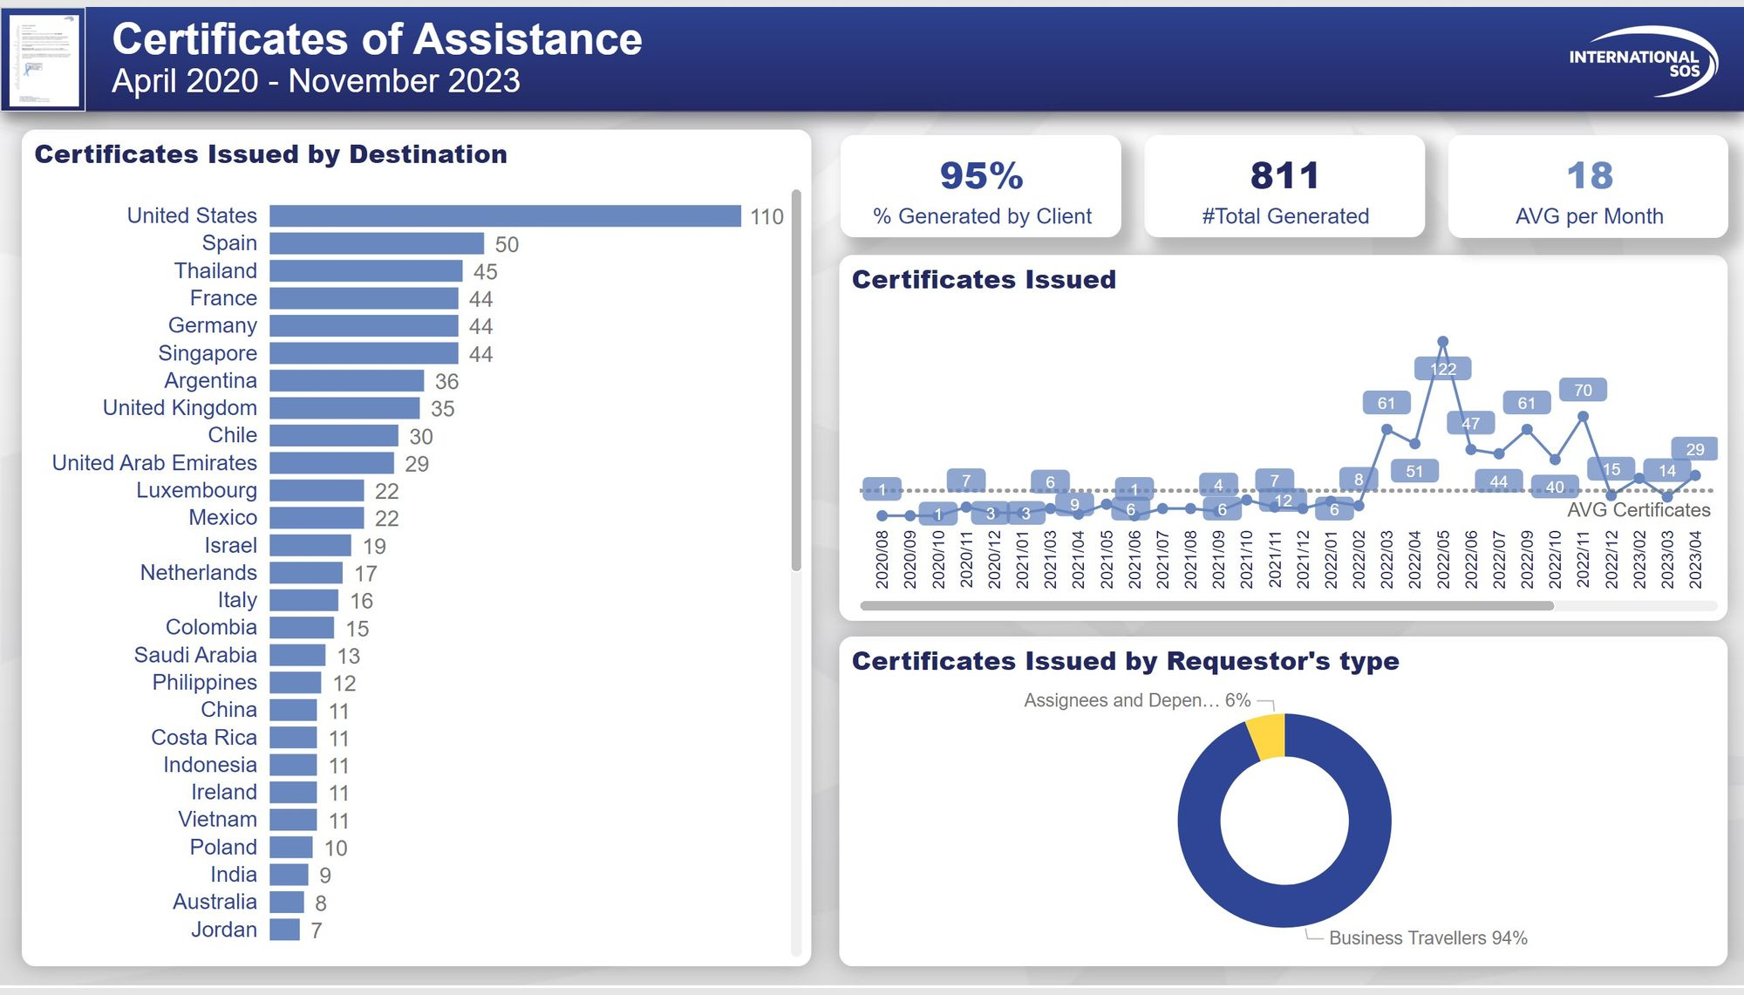

Slide 49


Slide 50
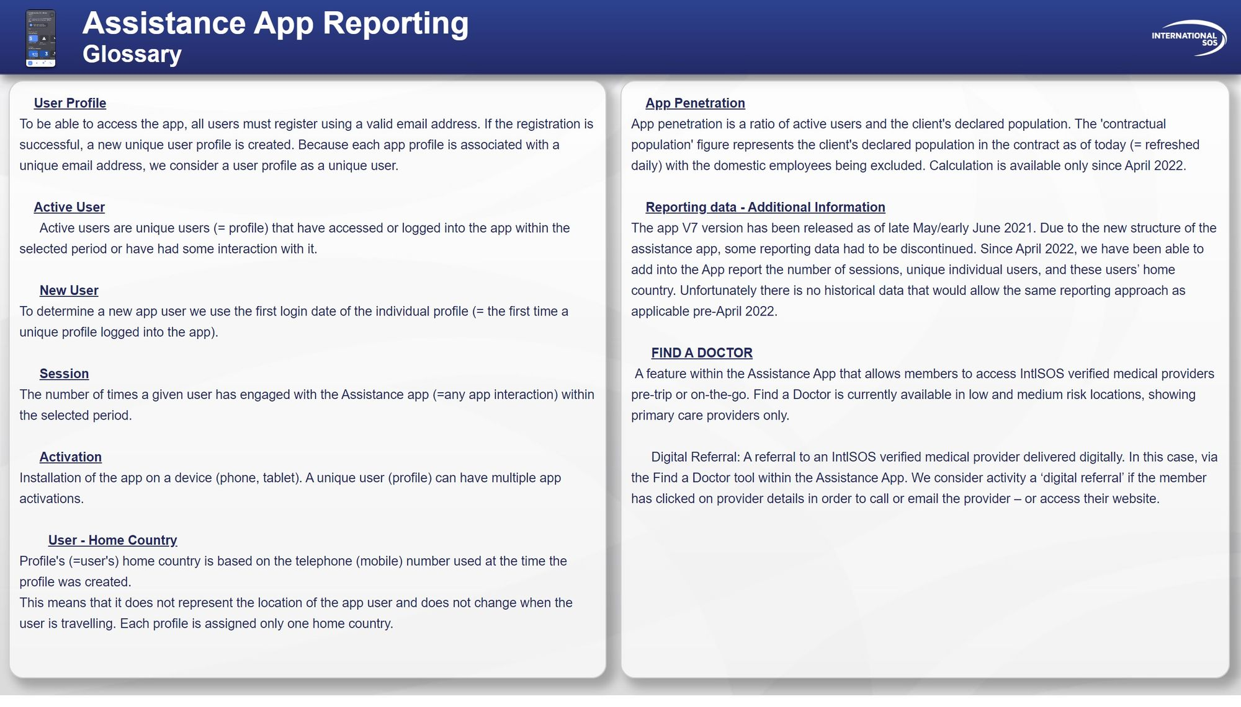

Slide 51
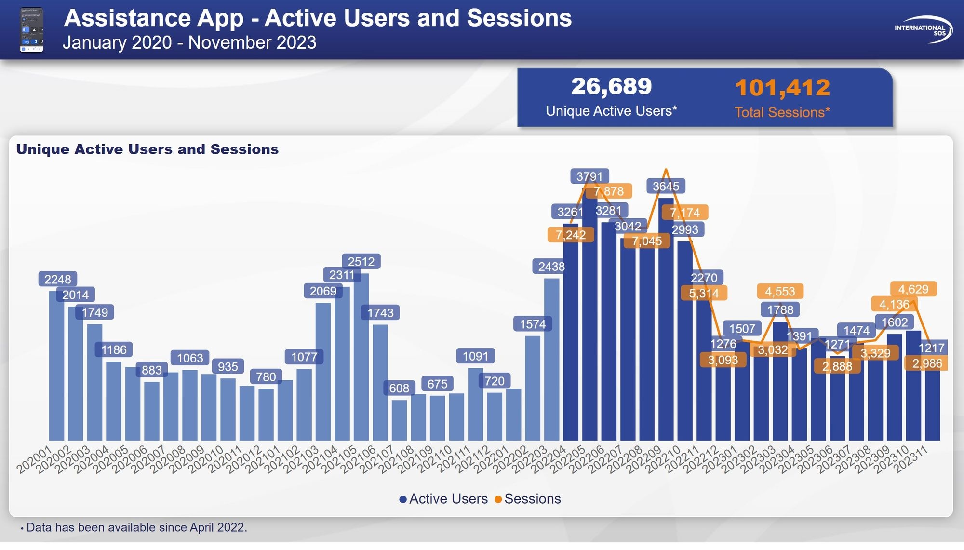

Slide 52
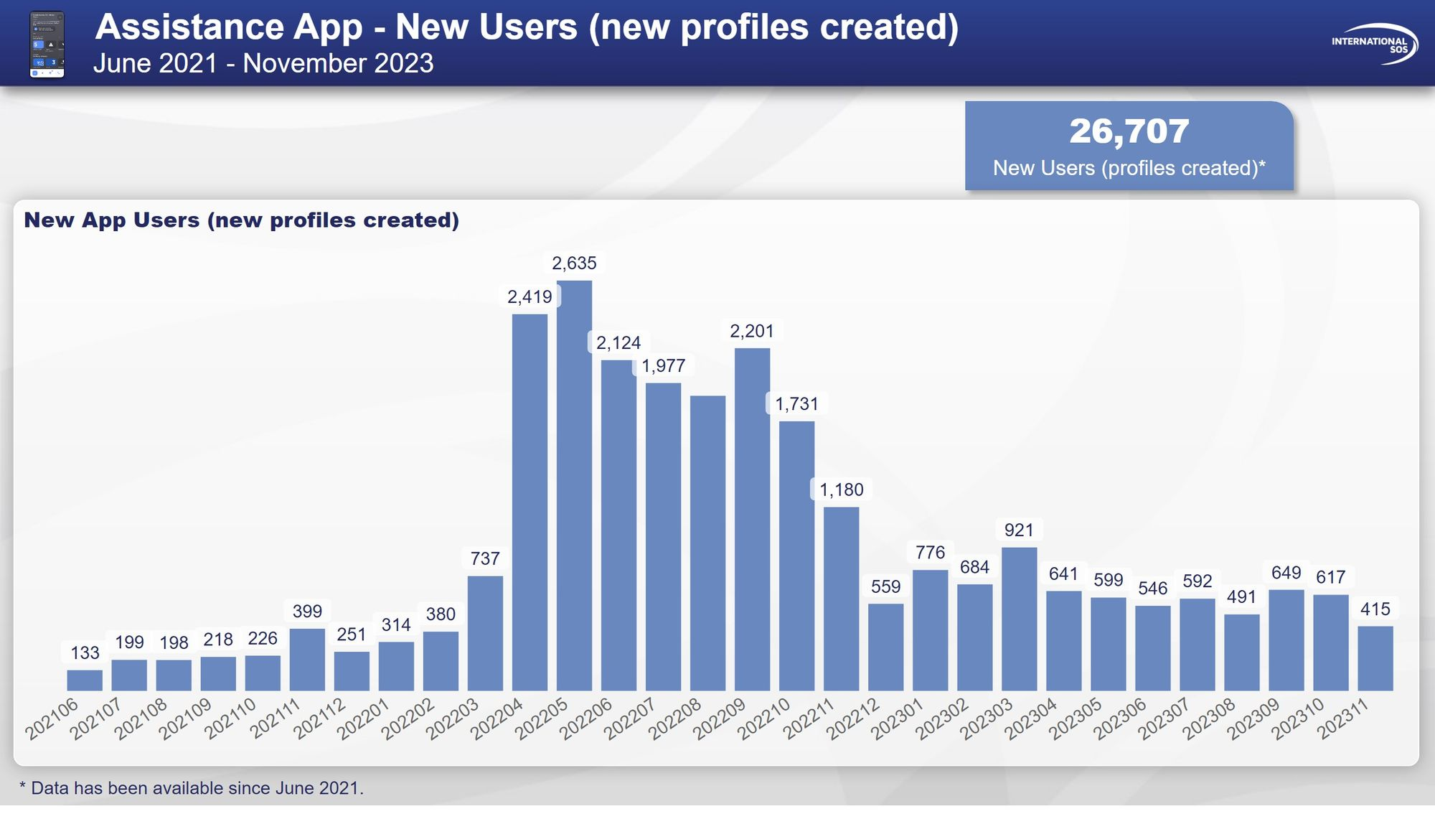

Slide 53
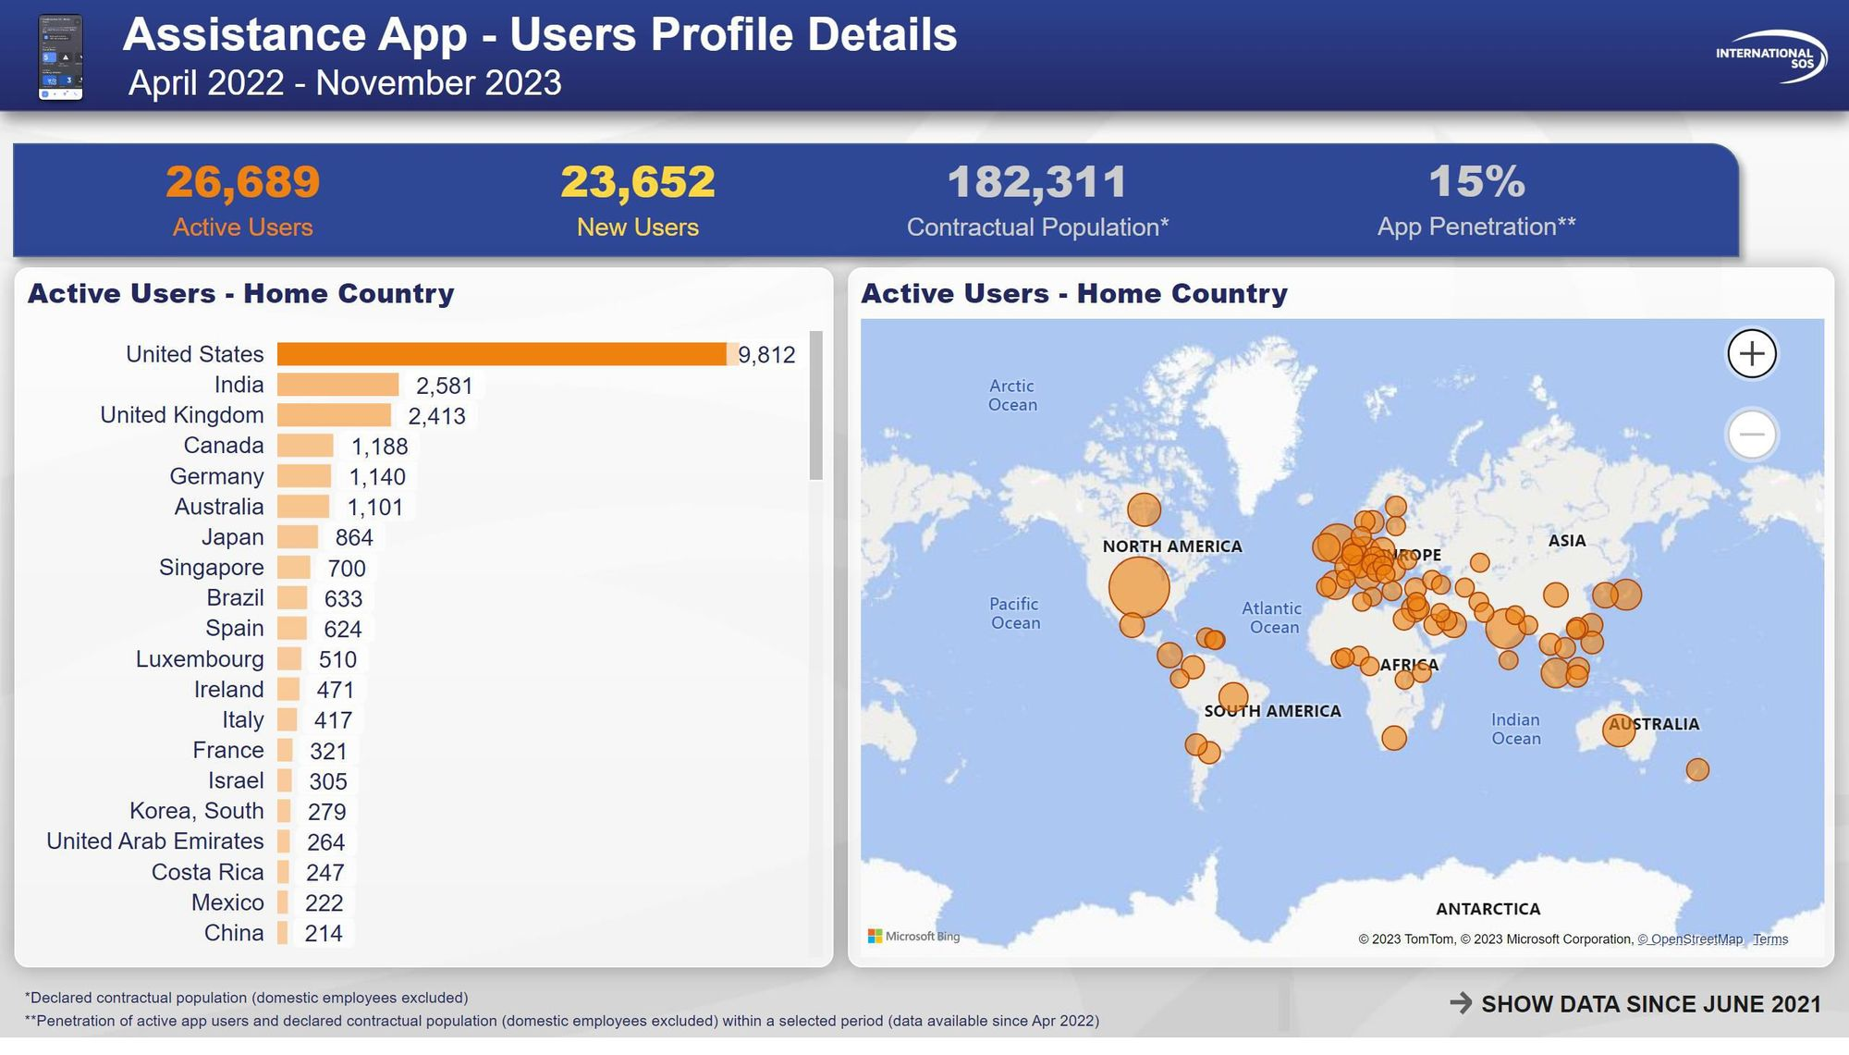

Slide 54
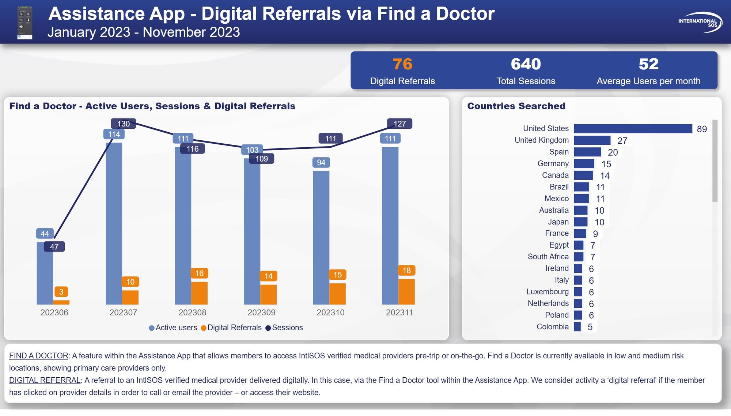

Slide 55
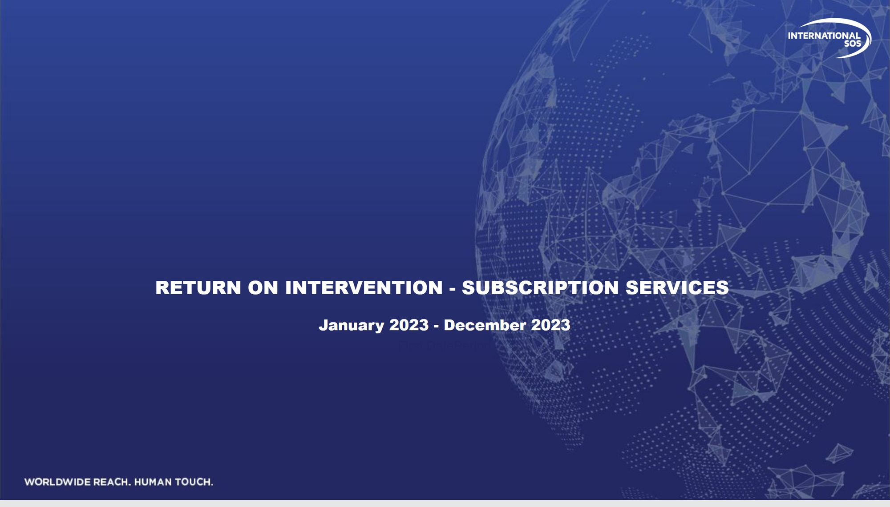
Title Page
Notes:
slicer
No alt text provided
image
No alt text provided
slicer
No alt text provided
slicer
No alt text provided
card
No alt text provided
textbox
No alt text provided
slicer
No alt text provided
slicer
No alt text provided
slicer
No alt text provided
actionButton
No alt text provided
actionButton
No alt text provided
slicer
No alt text provided
slicer
No alt text provided
textbox
No alt text provided
basicShape
No alt text provided
image
No alt text provided

Slide 56
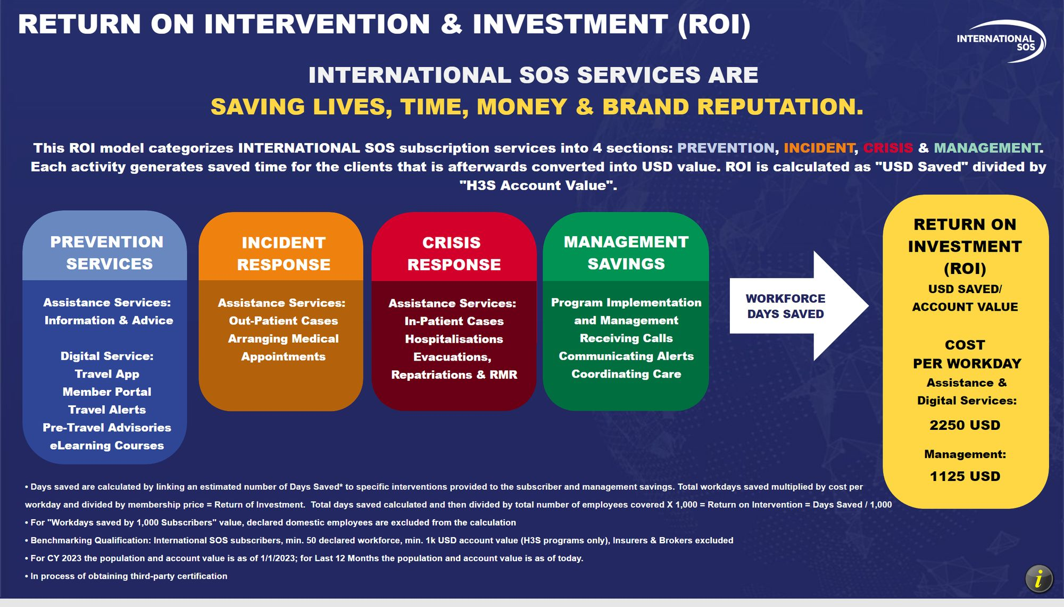
Methodology 1/2
Notes:
textbox
No alt text provided
image
No alt text provided
shape
No alt text provided
shape
No alt text provided
textbox
No alt text provided
textbox
No alt text provided
shape
No alt text provided
textbox
No alt text provided
shape
No alt text provided
textbox
No alt text provided
shape
No alt text provided
textbox
No alt text provided
card
No alt text provided
card
No alt text provided
textbox
No alt text provided
textbox
No alt text provided
shape
No alt text provided
shape
No alt text provided
shape
No alt text provided
shape
No alt text provided
textbox
No alt text provided
image
No alt text provided
slicer
No alt text provided
slicer
No alt text provided
slicer
No alt text provided
areaChart
No alt text provided
lineChart
No alt text provided
map
No alt text provided
lineChart
No alt text provided
lineChart
No alt text provided
slicer
No alt text provided
slicer
No alt text provided
slicer
No alt text provided
lineChart
No alt text provided
image
No alt text provided
shape
No alt text provided
slicer
No alt text provided
slicer
No alt text provided
slicer
No alt text provided
slicer
No alt text provided
textbox
No alt text provided
slicer
No alt text provided
textbox
No alt text provided
lineChart
No alt text provided
slicer
No alt text provided
slicer
No alt text provided
shape
No alt text provided
textbox
No alt text provided
lineChart
No alt text provided
lineChart
No alt text provided
lineChart
No alt text provided
lineChart
No alt text provided
card
No alt text provided
card
No alt text provided
shape
No alt text provided
areaChart
No alt text provided
clusteredBarChart
No alt text provided
clusteredBarChart
No alt text provided
clusteredBarChart
No alt text provided
clusteredBarChart
No alt text provided
clusteredBarChart
No alt text provided
slicer
No alt text provided

Slide 57

Methodology 2/2
Notes:
image
No alt text provided
Digital Services
No alt text provided
Workdays Saved by Assistance Services
No alt text provided
Assistance Services
No alt text provided
Workdays Saved by Assistance Services
No alt text provided
shape
No alt text provided
shape
No alt text provided
shape
No alt text provided
shape
No alt text provided
textbox
No alt text provided
textbox
No alt text provided
textbox
No alt text provided
textbox
No alt text provided
shape
No alt text provided
textbox
No alt text provided
textbox
No alt text provided
image
No alt text provided
slicer
No alt text provided
slicer
No alt text provided
slicer
No alt text provided
areaChart
No alt text provided
lineChart
No alt text provided
map
No alt text provided
lineChart
No alt text provided
lineChart
No alt text provided
slicer
No alt text provided
slicer
No alt text provided
slicer
No alt text provided
lineChart
No alt text provided
image
No alt text provided
shape
No alt text provided
slicer
No alt text provided
slicer
No alt text provided
slicer
No alt text provided
slicer
No alt text provided
textbox
No alt text provided
slicer
No alt text provided
textbox
No alt text provided
lineChart
No alt text provided
slicer
No alt text provided
slicer
No alt text provided
lineChart
No alt text provided
lineChart
No alt text provided
lineChart
No alt text provided
lineChart
No alt text provided
card
No alt text provided
card
No alt text provided
shape
No alt text provided
areaChart
No alt text provided
clusteredBarChart
No alt text provided
clusteredBarChart
No alt text provided
clusteredBarChart
No alt text provided
clusteredBarChart
No alt text provided
clusteredBarChart
No alt text provided
slicer
No alt text provided

Slide 58

Global ROI
Notes:
clusteredColumnChart
No alt text provided
image
No alt text provided
lineStackedColumnComboChart
No alt text provided
shape
No alt text provided
slicer
No alt text provided
textbox
No alt text provided
slicer
No alt text provided
image
No alt text provided
slicer
No alt text provided
clusteredBarChart
No alt text provided
slicer
No alt text provided
slicer
No alt text provided
slicer
No alt text provided
slicer
No alt text provided
shape
No alt text provided
image
No alt text provided
slicer
No alt text provided
multiRowCard
No alt text provided
card
No alt text provided
shape
No alt text provided
slicer
No alt text provided
areaChart
No alt text provided
lineChart
No alt text provided
lineChart
No alt text provided
lineChart
No alt text provided
lineChart
No alt text provided
lineChart
No alt text provided
map
No alt text provided
lineChart
No alt text provided
lineChart
No alt text provided
card
No alt text provided
card
No alt text provided
shape
No alt text provided
areaChart
No alt text provided
clusteredBarChart
No alt text provided
clusteredBarChart
No alt text provided
clusteredBarChart
No alt text provided
clusteredBarChart
No alt text provided
clusteredBarChart
No alt text provided
lineChart
No alt text provided
shape
No alt text provided
textbox
No alt text provided
textbox
No alt text provided
lineChart
No alt text provided

Slide 59

Client Overview
Notes:
slicer
No alt text provided
slicer
No alt text provided
image
No alt text provided
card
No alt text provided
card
No alt text provided
card
No alt text provided
DISTRIBUTION OF ROI
No alt text provided
textbox
No alt text provided
textbox
No alt text provided
textbox
No alt text provided
card
No alt text provided
textbox
No alt text provided
shape
No alt text provided
slicer
No alt text provided
slicer
No alt text provided
multiRowCard
No alt text provided
slicer
No alt text provided
slicer
No alt text provided
slicer
No alt text provided
areaChart
No alt text provided
lineChart
No alt text provided
lineChart
No alt text provided
lineChart
No alt text provided
lineChart
No alt text provided
lineChart
No alt text provided
map
No alt text provided
lineChart
No alt text provided
lineChart
No alt text provided
card
No alt text provided
card
No alt text provided
shape
No alt text provided
areaChart
No alt text provided
clusteredBarChart
No alt text provided
clusteredBarChart
No alt text provided
clusteredBarChart
No alt text provided
clusteredBarChart
No alt text provided
clusteredBarChart
No alt text provided
slicer
No alt text provided
slicer
No alt text provided
slicer
No alt text provided
lineChart
No alt text provided
image
No alt text provided
shape
No alt text provided
slicer
No alt text provided
slicer
No alt text provided
slicer
No alt text provided
slicer
No alt text provided
textbox
No alt text provided
slicer
No alt text provided
textbox
No alt text provided
lineChart
No alt text provided

Slide 60

Client Detailed
Notes:
card
No alt text provided
card
No alt text provided
textbox
No alt text provided
card
No alt text provided
slicer
No alt text provided
slicer
No alt text provided
image
No alt text provided
textbox
No alt text provided
textbox
No alt text provided
textbox
No alt text provided
textbox
No alt text provided
textbox
No alt text provided
textbox
No alt text provided
textbox
No alt text provided
textbox
No alt text provided
textbox
No alt text provided
textbox
No alt text provided
card
No alt text provided
card
No alt text provided
DISTRIBUTION OF ROI
No alt text provided
shape
No alt text provided
shape
No alt text provided
clusteredBarChart
No alt text provided
clusteredBarChart
No alt text provided
clusteredBarChart
No alt text provided
clusteredBarChart
No alt text provided
clusteredBarChart
No alt text provided
clusteredBarChart
No alt text provided
clusteredBarChart
No alt text provided
clusteredBarChart
No alt text provided
slicer
No alt text provided
multiRowCard
No alt text provided
clusteredBarChart
No alt text provided
textbox
No alt text provided
textbox
No alt text provided
slicer
No alt text provided
slicer
No alt text provided
slicer
No alt text provided
areaChart
No alt text provided
lineChart
No alt text provided
lineChart
No alt text provided
lineChart
No alt text provided
lineChart
No alt text provided
lineChart
No alt text provided
map
No alt text provided
lineChart
No alt text provided
lineChart
No alt text provided
card
No alt text provided
card
No alt text provided
shape
No alt text provided
areaChart
No alt text provided
clusteredBarChart
No alt text provided
clusteredBarChart
No alt text provided
clusteredBarChart
No alt text provided
clusteredBarChart
No alt text provided
clusteredBarChart
No alt text provided
slicer
No alt text provided
slicer
No alt text provided
slicer
No alt text provided
lineChart
No alt text provided
image
No alt text provided
shape
No alt text provided
slicer
No alt text provided
slicer
No alt text provided
slicer
No alt text provided
slicer
No alt text provided
textbox
No alt text provided
slicer
No alt text provided
textbox
No alt text provided
lineChart
No alt text provided

Slide 61

Per Subscriber vs. Peers
Notes:
slicer
No alt text provided
image
No alt text provided
slicer
No alt text provided
slicer
No alt text provided
columnChart
No alt text provided
columnChart
No alt text provided
slicer
No alt text provided
slicer
No alt text provided
slicer
No alt text provided
image
No alt text provided
image
No alt text provided
card
No alt text provided
textbox
No alt text provided
textbox
No alt text provided
multiRowCard
No alt text provided
shape
No alt text provided
clusteredColumnChart
No alt text provided
slicer
No alt text provided
shape
No alt text provided
textbox
No alt text provided
columnChart
No alt text provided
columnChart
No alt text provided
clusteredColumnChart
No alt text provided
shape
No alt text provided
card
No alt text provided
textbox
No alt text provided
textbox
No alt text provided
multiRowCard
No alt text provided
image
No alt text provided
slicer
No alt text provided
multiRowCard
No alt text provided
slicer
No alt text provided
areaChart
No alt text provided
lineChart
No alt text provided
lineChart
No alt text provided
lineChart
No alt text provided
lineChart
No alt text provided
lineChart
No alt text provided
map
No alt text provided
lineChart
No alt text provided
lineChart
No alt text provided
card
No alt text provided
card
No alt text provided
shape
No alt text provided
areaChart
No alt text provided
clusteredBarChart
No alt text provided
clusteredBarChart
No alt text provided
clusteredBarChart
No alt text provided
clusteredBarChart
No alt text provided
clusteredBarChart
No alt text provided
lineChart
No alt text provided
image
No alt text provided
shape
No alt text provided
textbox
No alt text provided
textbox
No alt text provided
lineChart
No alt text provided

Slide 62

USD Saved vs. Peers
Notes:
slicer
No alt text provided
image
No alt text provided
slicer
No alt text provided
slicer
No alt text provided
columnChart
No alt text provided
columnChart
No alt text provided
slicer
No alt text provided
slicer
No alt text provided
slicer
No alt text provided
image
No alt text provided
image
No alt text provided
card
No alt text provided
textbox
No alt text provided
textbox
No alt text provided
multiRowCard
No alt text provided
shape
No alt text provided
clusteredColumnChart
No alt text provided
slicer
No alt text provided
shape
No alt text provided
textbox
No alt text provided
columnChart
No alt text provided
columnChart
No alt text provided
clusteredColumnChart
No alt text provided
shape
No alt text provided
card
No alt text provided
textbox
No alt text provided
textbox
No alt text provided
multiRowCard
No alt text provided
image
No alt text provided
slicer
No alt text provided
multiRowCard
No alt text provided
slicer
No alt text provided
areaChart
No alt text provided
lineChart
No alt text provided
lineChart
No alt text provided
lineChart
No alt text provided
lineChart
No alt text provided
lineChart
No alt text provided
map
No alt text provided
lineChart
No alt text provided
lineChart
No alt text provided
card
No alt text provided
card
No alt text provided
shape
No alt text provided
areaChart
No alt text provided
clusteredBarChart
No alt text provided
clusteredBarChart
No alt text provided
clusteredBarChart
No alt text provided
clusteredBarChart
No alt text provided
clusteredBarChart
No alt text provided
lineChart
No alt text provided
image
No alt text provided
shape
No alt text provided
textbox
No alt text provided
textbox
No alt text provided
lineChart
No alt text provided

Slide 63

Per Subscriber vs. Peers (Grouped)
Notes:
slicer
No alt text provided
image
No alt text provided
slicer
No alt text provided
slicer
No alt text provided
slicer
No alt text provided
slicer
No alt text provided
slicer
No alt text provided
image
No alt text provided
image
No alt text provided
textbox
No alt text provided
multiRowCard
No alt text provided
shape
No alt text provided
slicer
No alt text provided
shape
No alt text provided
textbox
No alt text provided
shape
No alt text provided
card
No alt text provided
textbox
No alt text provided
textbox
No alt text provided
multiRowCard
No alt text provided
image
No alt text provided
slicer
No alt text provided
multiRowCard
No alt text provided
clusteredColumnChart
No alt text provided
card
No alt text provided
clusteredColumnChart
No alt text provided
card
No alt text provided
shape
No alt text provided
multiRowCard
No alt text provided
textbox
No alt text provided
slicer
No alt text provided
image
No alt text provided
shape
No alt text provided
textbox
No alt text provided
textbox
No alt text provided

Slide 64

USD Saved vs. Peers (Grouped)
Notes:
slicer
No alt text provided
image
No alt text provided
slicer
No alt text provided
slicer
No alt text provided
slicer
No alt text provided
slicer
No alt text provided
slicer
No alt text provided
image
No alt text provided
image
No alt text provided
textbox
No alt text provided
multiRowCard
No alt text provided
shape
No alt text provided
slicer
No alt text provided
shape
No alt text provided
textbox
No alt text provided
shape
No alt text provided
card
No alt text provided
textbox
No alt text provided
textbox
No alt text provided
multiRowCard
No alt text provided
image
No alt text provided
slicer
No alt text provided
multiRowCard
No alt text provided
lineClusteredColumnComboChart
No alt text provided
card
No alt text provided
lineClusteredColumnComboChart
No alt text provided
card
No alt text provided
shape
No alt text provided
multiRowCard
No alt text provided
textbox
No alt text provided
slicer
No alt text provided
image
No alt text provided
shape
No alt text provided
textbox
No alt text provided
textbox
No alt text provided

Slide 65

Client vs. Peers Detailed
Notes:
card
No alt text provided
card
No alt text provided
textbox
No alt text provided
card
No alt text provided
textbox
No alt text provided
textbox
No alt text provided
textbox
No alt text provided
textbox
No alt text provided
textbox
No alt text provided
textbox
No alt text provided
textbox
No alt text provided
textbox
No alt text provided
textbox
No alt text provided
textbox
No alt text provided
shape
No alt text provided
clusteredBarChart
No alt text provided
clusteredBarChart
No alt text provided
clusteredBarChart
No alt text provided
clusteredBarChart
No alt text provided
clusteredBarChart
No alt text provided
clusteredBarChart
No alt text provided
clusteredBarChart
No alt text provided
clusteredBarChart
No alt text provided
clusteredBarChart
No alt text provided
textbox
No alt text provided
textbox
No alt text provided
card
No alt text provided
card
No alt text provided
card
No alt text provided
multiRowCard
No alt text provided
shape
No alt text provided
slicer
No alt text provided
slicer
No alt text provided
slicer
No alt text provided
slicer
No alt text provided
image
No alt text provided
image
No alt text provided
image
No alt text provided
slicer
No alt text provided
slicer
No alt text provided
slicer
No alt text provided
slicer
No alt text provided
image
No alt text provided
textbox
No alt text provided
textbox
No alt text provided
textbox
No alt text provided
textbox
No alt text provided
textbox
No alt text provided
textbox
No alt text provided
textbox
No alt text provided
textbox
No alt text provided
textbox
No alt text provided
textbox
No alt text provided
shape
No alt text provided
clusteredBarChart
No alt text provided
clusteredBarChart
No alt text provided
clusteredBarChart
No alt text provided
clusteredBarChart
No alt text provided
clusteredBarChart
No alt text provided
clusteredBarChart
No alt text provided
clusteredBarChart
No alt text provided
clusteredBarChart
No alt text provided
slicer
No alt text provided
multiRowCard
No alt text provided
clusteredBarChart
No alt text provided
textbox
No alt text provided
textbox
No alt text provided
slicer
No alt text provided
slicer
No alt text provided
slicer
No alt text provided
areaChart
No alt text provided
lineChart
No alt text provided
lineChart
No alt text provided
lineChart
No alt text provided
lineChart
No alt text provided
lineChart
No alt text provided
map
No alt text provided
lineChart
No alt text provided
lineChart
No alt text provided
card
No alt text provided
card
No alt text provided
shape
No alt text provided
areaChart
No alt text provided
clusteredBarChart
No alt text provided
clusteredBarChart
No alt text provided
clusteredBarChart
No alt text provided
clusteredBarChart
No alt text provided
clusteredBarChart
No alt text provided
slicer
No alt text provided
slicer
No alt text provided
slicer
No alt text provided
lineChart
No alt text provided
image
No alt text provided
shape
No alt text provided
slicer
No alt text provided
slicer
No alt text provided
slicer
No alt text provided
slicer
No alt text provided
textbox
No alt text provided
slicer
No alt text provided
textbox
No alt text provided
lineChart
No alt text provided

